Slide 1

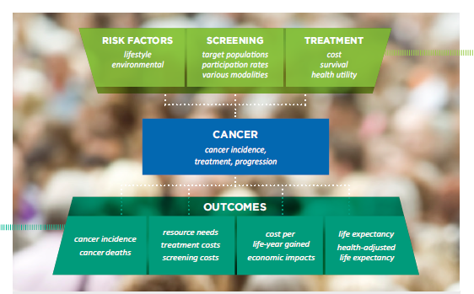
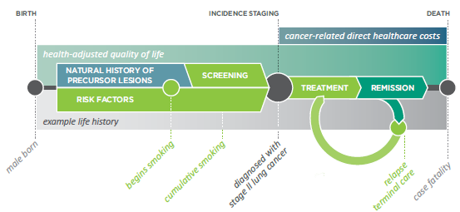
Annual vs. biennial lung cancer screening – using the Cancer Risk Management Model (CRMM) to fill gaps in evidence
Fitzgerald, N¹; Goffin, J²; Miller, AB³; Memon, S¹; Flanagan, W⁴; Evans, WK⁵
1 –Canadian Partnership Against Cancer; 2 – McMaster University, 3 – University of Toronto; 4 – Statistics Canada; 5 – Cancer Care Ontario
Background & Objectives
Lung cancer is the most commonly diagnosed cancer in Canada and the leading cause of cancer death in men and women.
The National Lung Screening Trial (NLST) in the United States demonstrated a 20% mortality reduction with annual low-dose computed tomography (LDCT) screening in current and former smokers age 55-74 with a 30 pack-year history.
There have not been any clinical trials evaluating a biennial lung cancer screening program.
OBJECTIVE: To assess the impact of lengthening the lung screening interval from annual to biennial in Canadians who comply with the NLST eligibility criteria using the Cancer Risk Management Model (CRMM).
Results
Incidence: Within the cohort, an initial increase in the number of new cases is observed with both screening scenarios.
Deaths: After ten years of annual screening, a 9% reduction in lung cancer deaths is observed. In the biennial screening program, an 8% reduction in lung cancer deaths is observed.
Cost-effectiveness: The cost-effectiveness ratio of annual lung cancer screening is projected to be $70,000 per QALY, while in the biennial screening arm, a more favourable outcome of $32,000 per QALY is observed.
Methodology
The CRMM* (version 2.1) is a continuous-time, Monte-Carlo micro-simulation model that allows the assessment of the effect of cancer control strategies on disease incidence, mortality, direct costs and economic impacts.
Lifetime results for cohort (55-74 years old in 2014) | Cost of screening ($M) | Cost of treatment ($M) | QALYs | ICER (cost/ QALY)
No Screening | $0 | $8,900 | 102,090,000
Annual Screening | $3,900 | $9,500 | 102,155,000 | $70,000
Biennial Screening | $2,200 | $9,200 | 102,166,000 | $32,000
The CRMM performs simulations at an individual level and incorporates demographic data, cancer risk factors and registry data, diagnostic and treatment algorithms and health utilities.
The model incorporates Canadian demographic data, cancer risk factors, registry data, population surveys and census data, diagnostic and treatment algorithms, costs and health utilities.
Simulations were performed with a cohort aged 55-74 in 2014 with a 30+ pack-year smoking history and former smokers who quit no more than 15 years prior.
Annual and biennial screening programs were compared to no screening.
Costs are reported in $2008 CDN from the public payer perspective.
Costs and outcomes are discounted at 3%.
*QALY = quality-adjusted life-year; ICER = incremental cost-effectiveness ratio
Conclusions
In the annual and biennial lung cancer screening programs, an initial increase in the number of new lung cancer cases are diagnosed, as well as a reduction in the number of lung cancer deaths is observed.
Biennial lung cancer screening results in comparable reductions in lung cancer mortality to annual screening, but with lower screening and treatment costs. Due to the reduction in unnecessary treatments, biennial screening is also associated with an increase in the number of quality-adjusted life-years.
Biennial lung cancer screening is more cost-effective than annual screening due to reduced costs and harms, while maintaining similar benefits.
In the absence of a clinical trial evaluating the cost-effectiveness of biennial lung cancer screening, the Cancer Risk Management Model is a publically available tool that can support these types of policy decisions in Canada.
*The CRMM has been made possible through a financial contribution from Health Canada, through the Partnership. The assumptions and calculations underlying the simulation results were prepared by the authors and the responsibility for the use and interpretation of these data is entirely that of the authors.
FURTHER INFORMATION: www.cancerview.ca/cancerriskmanagement
E-mail: riskmgmt@cancerview.ca

