Slide 1

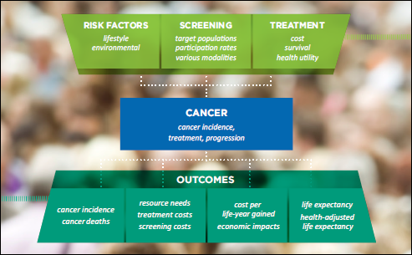
Comparing the health and economic impacts of two screening strategies for colorectal cancer in Canada using the Cancer Risk Management Model (CRMM)
Saima Memon¹, Anthony B Miller², William M Flanagan³, Claude Nadeau³, Craig Earle⁴,Natalie Fitzgerald¹, Andy J Coldman⁵
¹Canadian Partnership Against Cancer, Toronto, ON, CA; ²Dalla Lana School of Public Health, Toronto, ON, CA; ³Statistics Canada, Ottawa, ON, CA; ⁴ Institute for Clinical Evaluative Sciences, Toronto, ON, CA, ⁵BC Cancer Agency, Vancouver, BC, CA
Objective:
To compare the health and economic impacts of biennial fecal
immunochemical test (FIT) at the 100 ng/ml cut point and biennial guaiac fecal occult blood test (gFOBT) for colorectal cancer (CRC) screening using the Cancer Risk Management Model (CRMM) 2.1
Results:
Methodology:
The CRMM is a Monte-Carlo microsimulation model that simulates the natural history of CRC from onset within the colon or rectum, and progression to mortality
through different stages of
cancer.
CRMM performs simulations
at an individual level and
incorporates demographic data,
cancer risk factors and registry
data, diagnostic and treatment
algorithms and health utilities.
The natural history model
has been informed by literature and vetted by expert panels.
Eligibility criteria included average-risk males and females aged 50-74
with a 60% participation rate recruited from 2014 onwards. A ten-year phase-in period was assumed for the cohort in 2014 and there was no phase-in for cohorts entering in 2015 onward.
By 2050, biennial gFOBT and FIT demonstrate a reduction in the incidence of CRC of up to 2,500 and 7,500 cases respectively compared to “No Screening”.
By 2050, biennial gFOBT and FIT demonstrate a reduction in the incidence rate of CRC by 7 and 18 per 100,000 respectively compared to “No Screening”
Colorectal Natural History Model
Normal
Preclinical CRC
Stage 1 (TMN)
Clinical CRC
Stage 1 (TMN)
Non-resectable distant or local recurrence
Neoplastic polyps (≤5 mm)
Preclinical CRC
Stage 2 (TMN)
Clinical CRC
Stage 2 (TMN)
Compared to “No Screening”, biennial gFOBT and FIT demonstrate a reduction in the number of CRC deaths by 2,800 and 4,800 deaths respectively
By 2050, biennial FIT screening results in income and tax gains of approximately $920M compared to biennial gFOBT screening. Biennial FIT also results in net cost savings of approximately $110M as the cost of treatment is lower compared to biennial gFOBT.
Neoplastic polyps (6-9 mm)
Preclinical CRC
Stage 3 (TMN)
Clinical CRC
Stage 3 (TMN)
Death
Limitations:
Historical ad-hoc or programmatic screening nor use of colonoscopy in high risk and average risk patients were considered in the calibration of incidence to Canadian Cancer Registry Data.
Cure
Neoplastic polyps (≥10 mm)
Preclinical CRC
Stage 4 (TMN)
Clinical CRC
Stage 4 (TMN)
Conclusion:
CRMM indicates that a biennial FIT screening program would demonstrate a greater reduction in the incidence and deaths due to CRC, as well as superior cost-effectiveness profile than biennial gFOBT in the Canadian population aged 50-74.
Death from causes other than CRC is possible at any time.
Risk is thought to vary according to age, sex, location within the colon (6 locations) as well as an index of individual risk.
Progressive polyps include in situ (stage 0) CRC
Resectable recurrences are taken into account at the previous state (clinical CRC stages 1 to 3).
This analysis is based on the Canadian Partnership Against Cancer’s Cancer Risk Management Model 2.1. (CRMM). The CRMM has been made possible through a financial contribution from Health Canada, through the Partnership. The assumptions and calculations underlying the simulation results were prepared by the authors and the responsibility for the use and interpretation of these data is entirely that of the authors.
Compared to “No Screening”, biennial FIT demonstrates a superior incremental cost-effectiveness ratio (ICER) than biennial gFOBT.
FURTHER INFORMATION: www.cancerview.ca/cancerriskmanagement
E-mail: riskmgmt@cancerview.ca

