Slide 1
Key Statistics on Smoking amongst Cancer Patients in Canada
March 2017

Slide 2
Contents
Overview
Why is this resource important?
What information is contained in this resource?
How can I use this resource?
Methods
Scope + Limitations
Key Statistics
Suggested citation
Bibliography

Slide 3
Tobacco use in this document does not refer to use of traditional tobacco for ceremonial and/or spiritual purposes, it refers instead to misuse and cessation of commercial tobacco products

Slide 4
Why is this resource important?

Slide 5
Why is this resource important?
Tobacco use is the world’s leading cause of preventable death
Tobacco use costs Canadians billions of dollars each year in direct health care costs and indirect costs (e.g., lost productivity, long-term disability and death)

Slide 6
Why is this resource important?
Many cancer patients still smoke regularly (Lucchiari et al., 2013; U.S. Department of Health and Human Services (HHS) 2014)
About 20% of current cancer patients in Canada are smokers (Liu et al., 2016)
Cigarette smoking can reduce the effectiveness of cancer treatments and increase the risk of therapy-related side effects (Li et al., 2015)
Given the addictive nature of smoking and the high risk of relapse, the incorporation of smoking cessation efforts into cancer care is needed (HHS 2014; Warren & Ward, 2015)
Notes:
Data sources:
Lucchiari C, Masiero M, Botturi A, Pravettoni G. Helping patients to reduce tobacco consumption in oncology: a narrative review. Springerplus 2016;5:1136.
U.S. Department of Health and Human Services (HHS). The Health Consequences of Smoking: 50 Years of Progress. A Report of the Surgeon General. . Atlanta, GA: U.S. Department of Health and Human Services, Centers for Disease Control and Prevention, National Center for Chronic Disease Prevention and Health Promotion, Office on Smoking and Health., 2014.
Liu J, Chadder J, Fung S, Lockwood G, Rahal R, Halligan M, Mowat D, Bryant H. Smoking behaviours of current cancer patients in Canada. Current Oncology 2016; 23(3):201-203.
Li WHC, Chan SSC, Wang KMP, Lam TH. Helping cancer patients quit smoking by increasing their risk perception: a study protocol of a cluster randomized controlled trial. BMC Cancer 2015;15:490.
Warren GW, Ward KD. Integration of tobacco cessation services into multidisciplinary lung cancer care: rationale, state of the art, and future directions. Transl Lung Cancer Res 2015;4:339-52.

Slide 7
Why is this resource important?
Evidence indicates that tobacco cessation improves the effectiveness of treatment and likelihood of survival amongst all cancer patients, not just those with tobacco-related cancers, yet tobacco use is rarely addressed within oncology practice.
While evidence-based approaches to tobacco cessation exist in Canada, these services are rarely offered in cancer settings.

Slide 8
What information is contained in this resource?

Slide 9
What information is contained within this resource?
This resource includes:
Slides on key Canadian statistics on tobacco use amongst cancer patients
Overview of available data quantifying the potential burden of continued smoking by cancer patients in Canada
Each slide’s notes section contains complete citation information for statistics presented, easy to copy + paste

Slide 10
How can I use this resource?

Slide 11
How can I use this resource?
To support cancer agencies and governments in sustaining, spreading and scaling up evidence-based approaches to tobacco cessation within the cancer system, the Canadian Partnership Against Cancer has compiled multiple lines of evidence in a suite of resources.
These slides on key statistics are one of several resources available from the Partnership to support evidence-informed decision-making on tobacco cessation for cancer patients.

Slide 12
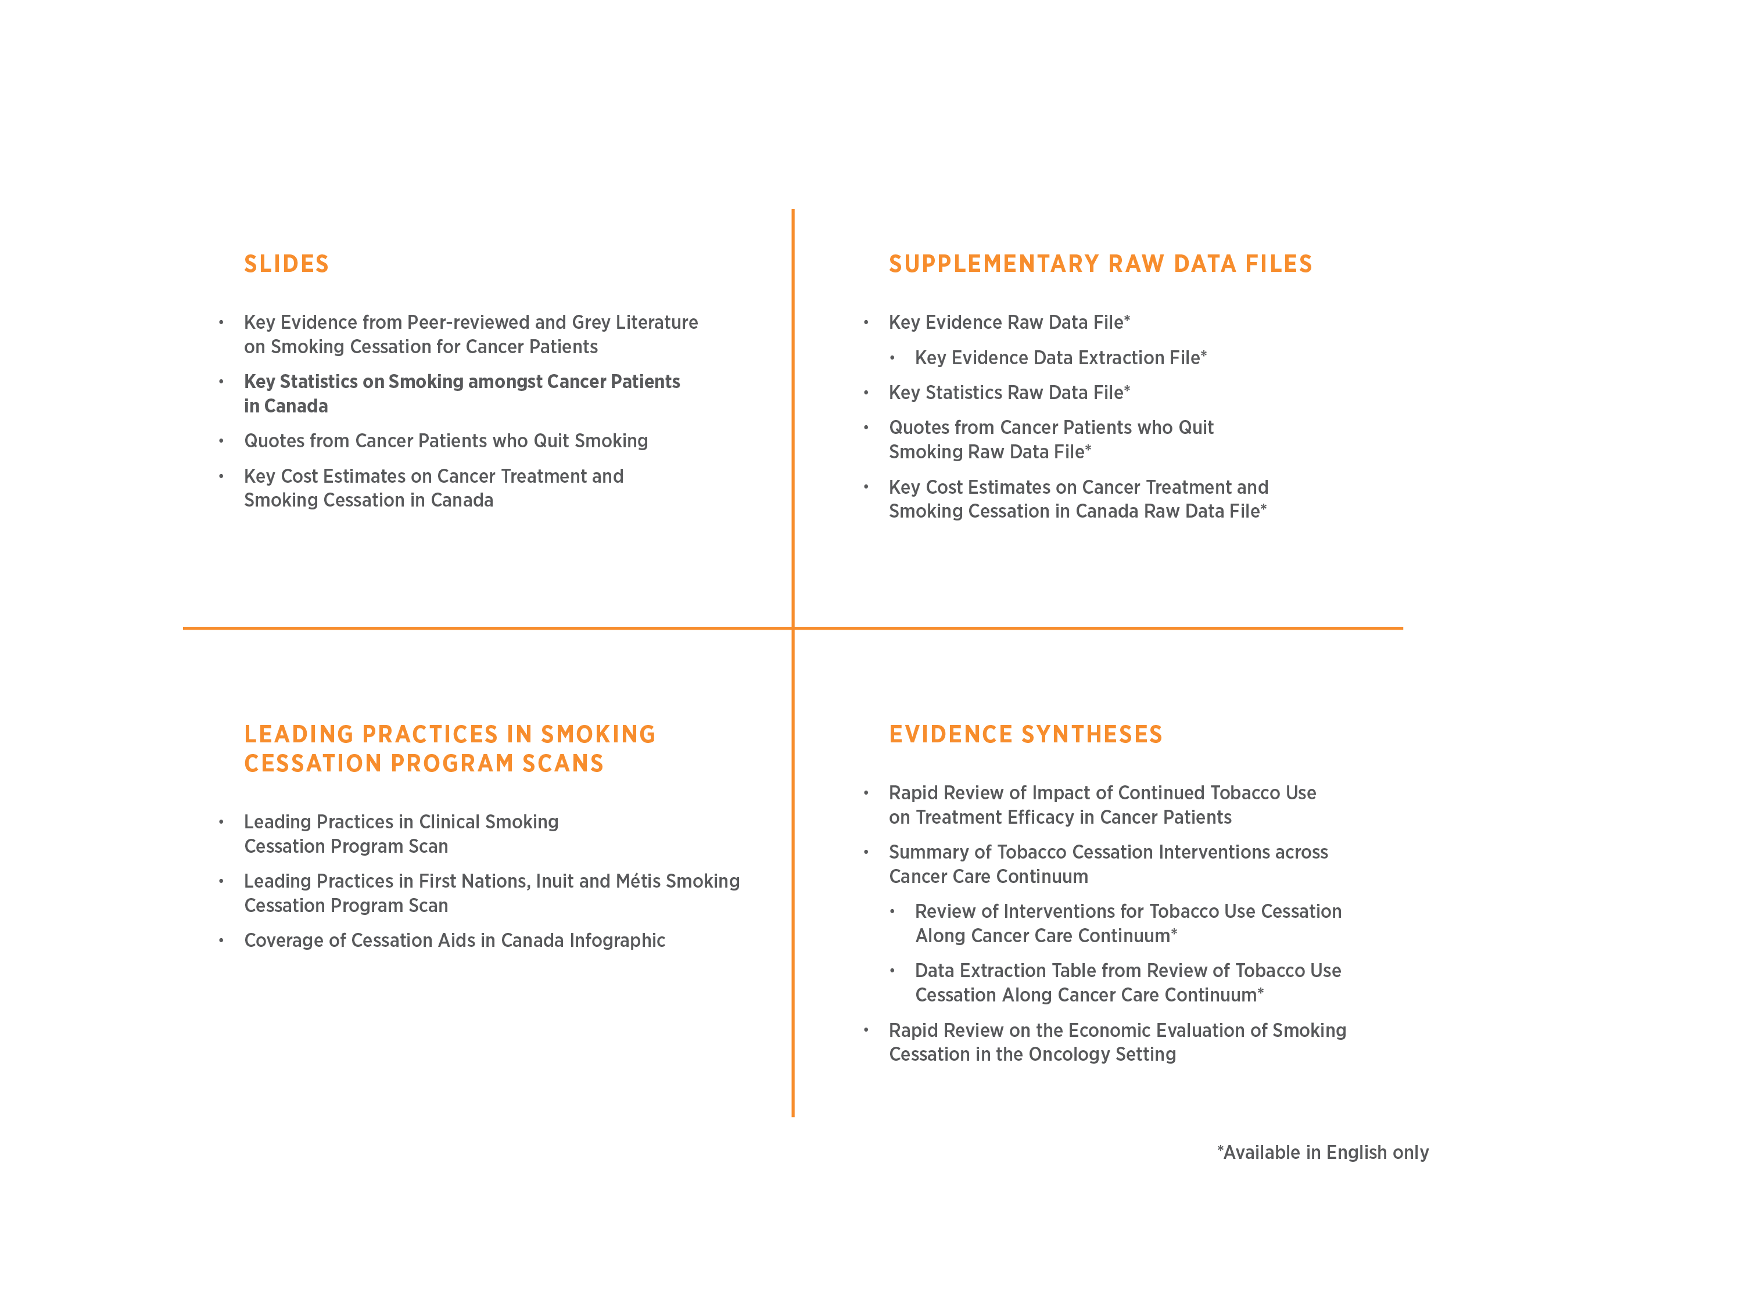
Suite of Tobacco Cessation in Cancer Systems Resources
www.cancerview.ca/tobacco

Slide 13
How can I use this resource?
Copy-and-paste slides, data, and/or figures into presentations, briefing notes
Copy-and-paste citations from notes sections of slides, or bibliography section
Cite the resource using the suggested citation in your presentations, briefings, reports, etc

Slide 14
Methods

Slide 15
Methods
Canadian daily/occasional smoking rates were identified from (data sources):
“Special Feature: Smoking behaviours in cancer patients” in the 2016 Cancer System Performance Report
Statistics Canada, Canadian Community Health Survey (CCHS)
Current Oncology peer-reviewed publication (Liu et al., 2016)
The data is reported by:
Current versus former smokers
Cancer patients versus non-cancer patients
Overall versus by gender

Slide 16
Scope and Limitations
Limited sources of evidence
No access to raw data for further analysis
Data not readily available on:
Number of cancer patients who use tobacco by province/territory and are eligible for coverage by federal, provincial, or territorial cessation aid programs
Number of cancer patients who use tobacco by province/territory and have private health insurance coverage

Slide 17
Scope and Limitations
Smoking status was assessed at the time of the survey only
In cancer patients who identified as non-smokers, it is unknown whether they may have been smokers earlier in their lives, or whether they smoked at the time of their first cancer diagnosis and treatment
The types of cancer are not differentiated in the results
Notes:
These caveats are for “current smokers” only as reported in the Cancer System Performance Report (citation below), but information on ”former smokers” was not reported. Additional information gathered on former smokers was attained from CPAC.
Data Source:
Canadian Partnership Against Cancer. “Special Feature: Smoking behaviours in cancer patients” in The 2016 Cancer System Performance Report. July 2016.

Slide 18
Scope and Limitations
Further research is needed to determine:
The number/percentage of cancer patients who use tobacco and are eligible for coverage by federal, provincial or territorial cessation aid programs
The number/percentage of cancer patients who use tobacco and have private health insurance coverage
The number/percentage of cancer patients who quit smoking prior to initiation of cancer treatment

Slide 19
Key Statistics
Notes:
Standardized to the 2011 Canadian population

Slide 20
Daily/occasional tobacco use
Approximately 20% of Canadian cancer patients report daily or occasional tobacco use (Liu et al., 2016)
This estimate is comparable to findings in the non-cancer patient population of whom 19.3% reported daily or occasional smoking (Liu et al., 2016)
Slightly more male cancer patients than female cancer patients (19%) identified as current smokers
More cancer patients than non-cancer patients are former smokers (CPAC System Performance, 2016)
Notes:
Liu J, Chadder J, Fung S, Lockwood G, Rahal R, Halligan M, Mowat D, Bryant H. Smoking behaviours of current cancer patients in Canada. Current Oncology 2016; 23(3):201-203.
Canadian Partnership Against Cancer. “Special Feature: Smoking behaviours in cancer patients” in The 2016 Cancer System Performance Report. July 2016.

Slide 21
Current daily/occasional smokers
Notes:
Percentage of Canadian individuals (aged ≥ 12) reporting daily or occasional smoking, by cancer status and sex, age-standardized to the 2011 Canadian population
Data source: Statistics Canada, Canadian Community Health Survey (CCHS), available through: Canadian Partnership Against Cancer. Figure 1.3 | Cancer System Performance [Internet]. 2016 [cited 2016 Nov 30]. Available from: http://www.systemperformance.ca/figure/1-3-en/

Slide 22
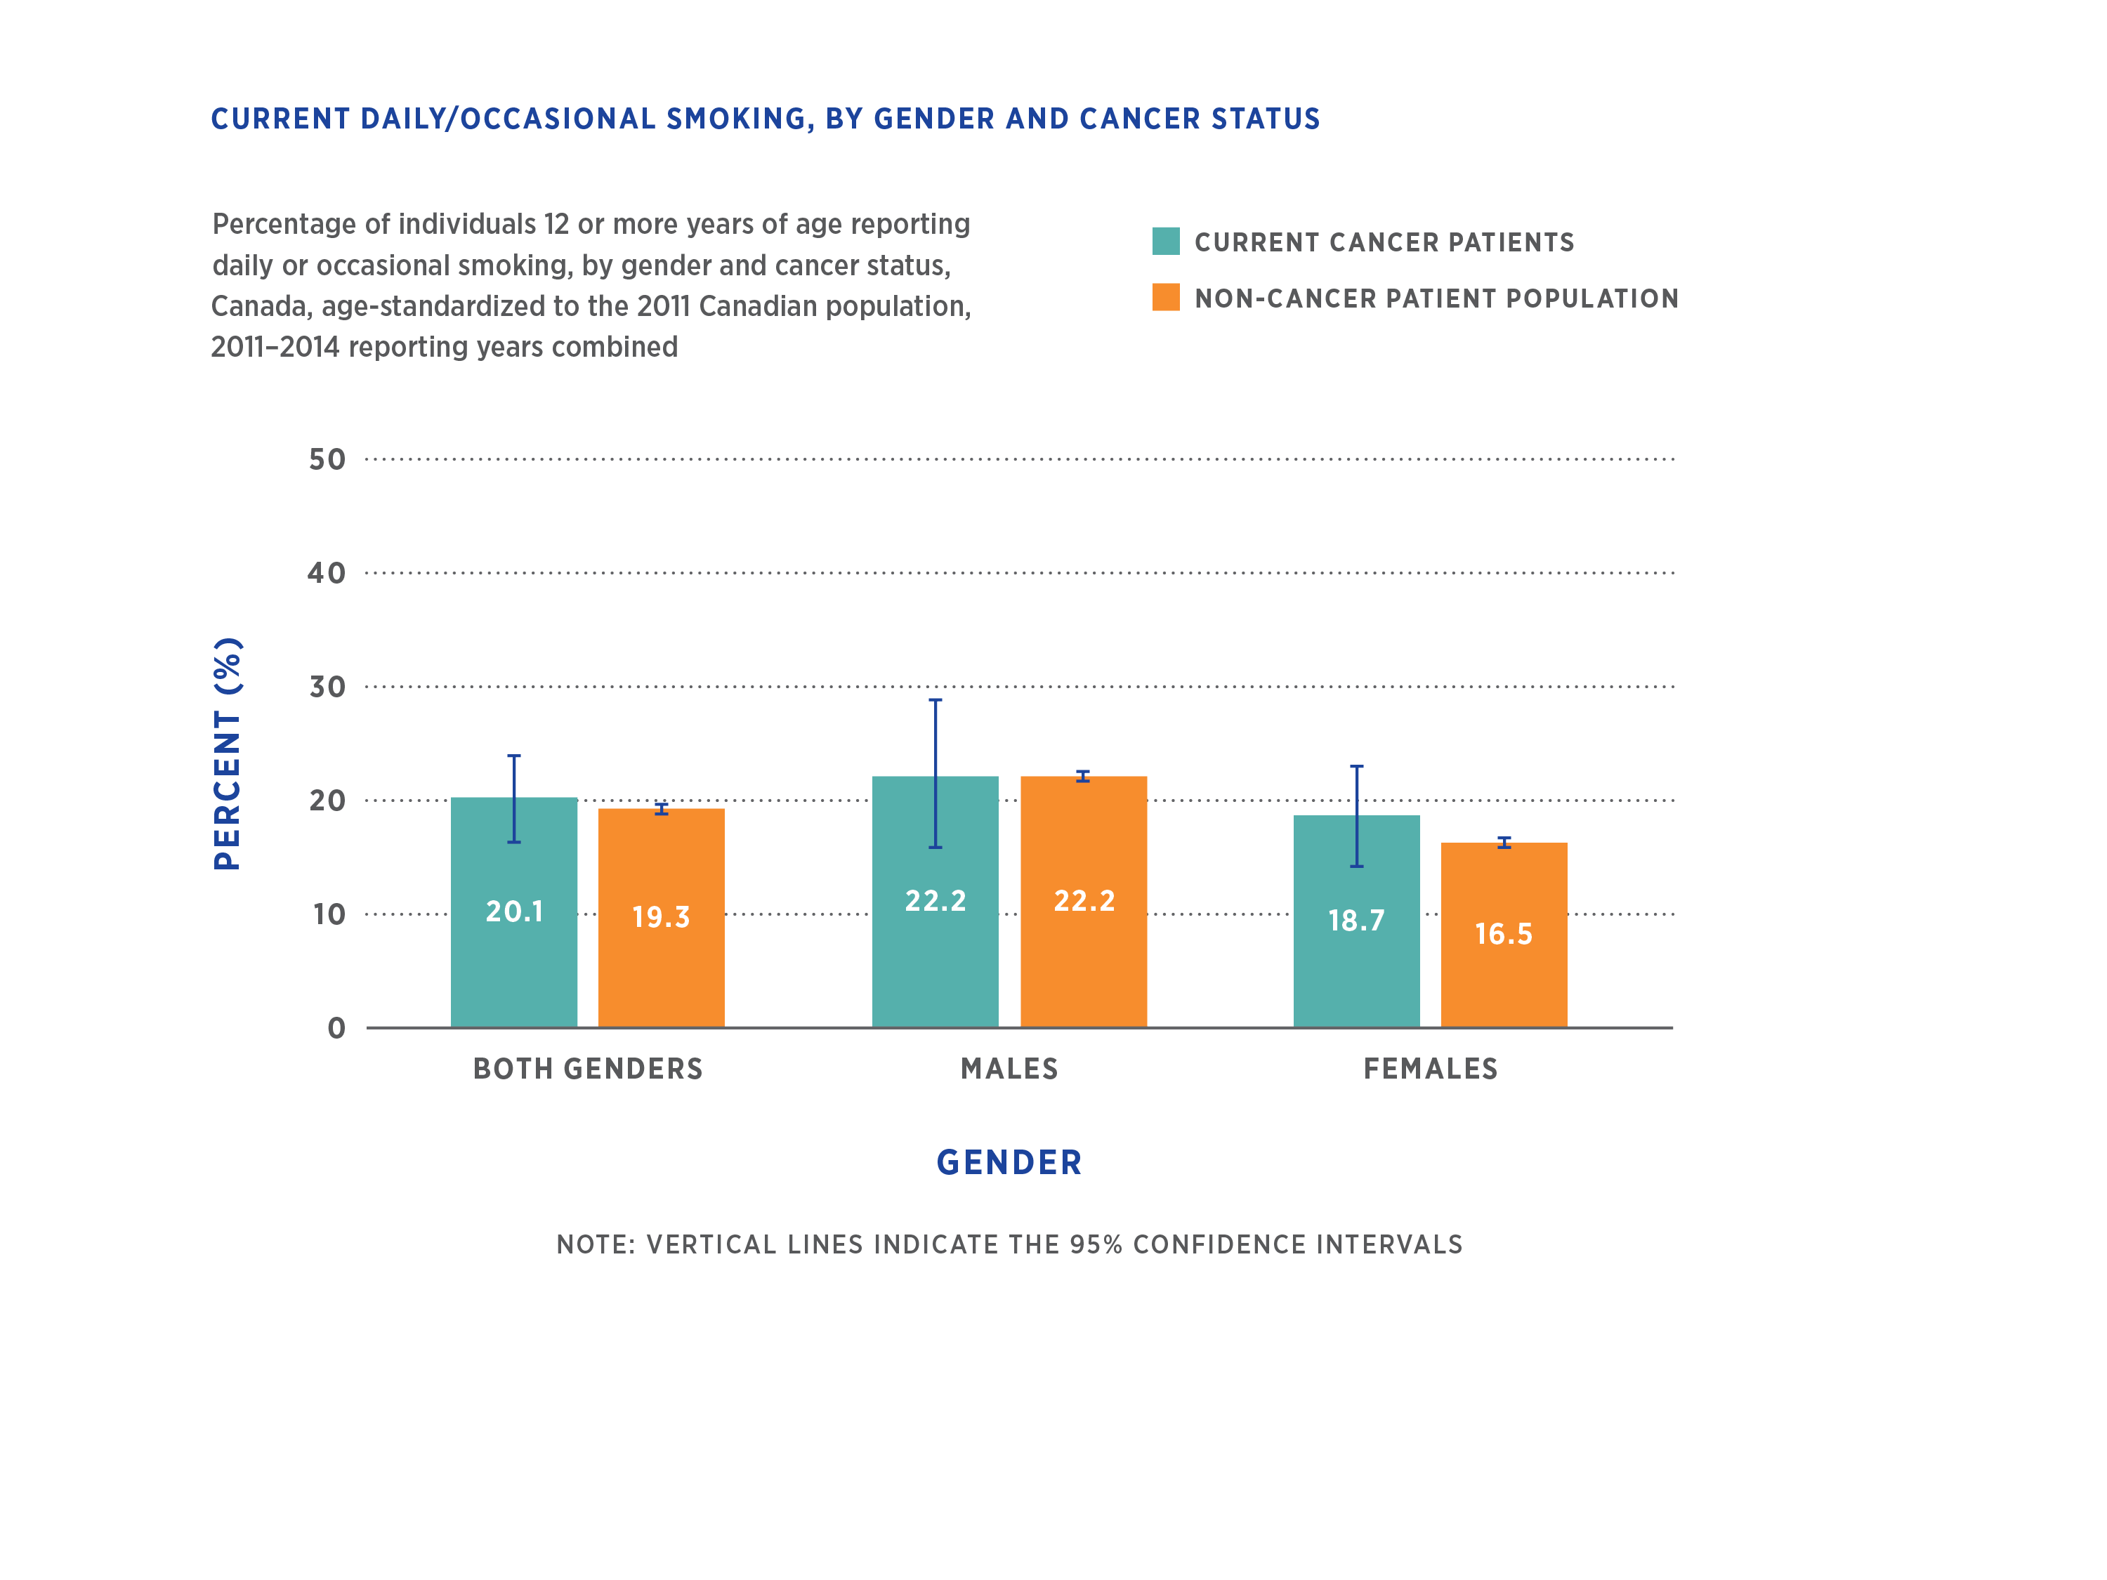
Current daily/occasional smoking, by gender and cancer status
Notes:
This difference was not significant, as per “Special Feature: Smoking behaviours in cancer patients” in The July 2016 Cancer System Performance Report
Figure data source:
Liu J, Chadder J, Fung S, Lockwood G, Rahal R, Halligan M, Mowat D, Bryant H. Smoking behaviours of current cancer patients in Canada. Current Oncology 2016; 23(3):201-203.

Slide 23
Former daily/occasional smokers
Notes:
Percentage of Canadian individuals (aged ≥ 12) reporting daily or occasional smoking, by cancer status and sex, age-standardized to the 2011 Canadian population
Data source: Statistics Canada, Canadian Community Health Survey (CCHS)

Slide 24
Suggested citation
Canadian Partnership Against Cancer. (2017). Key Statistics on Smoking amongst Cancer Patients in Canada. Retrieved Month XX, 20XX from: www.cancerview.ca/tobacco

Slide 25
Bibliography
Canadian Partnership Against Cancer. “Special Feature: Smoking behaviours in cancer patients” in The 2016 Cancer System Performance Report. July 2016.
Liu J, Chadder J, Fung S, Lockwood G, Rahal R, Halligan M, Mowat D, Bryant H. Smoking behaviours of current cancer patients in Canada. Current Oncology 2016; 23(3):201-203.

