Slide 1
Palliative and End-of-Life Care: A Cancer System Performance Report
September 2017
Figures and Tables

Slide 2
Palliative Care Bow Tie Model

Slide 3
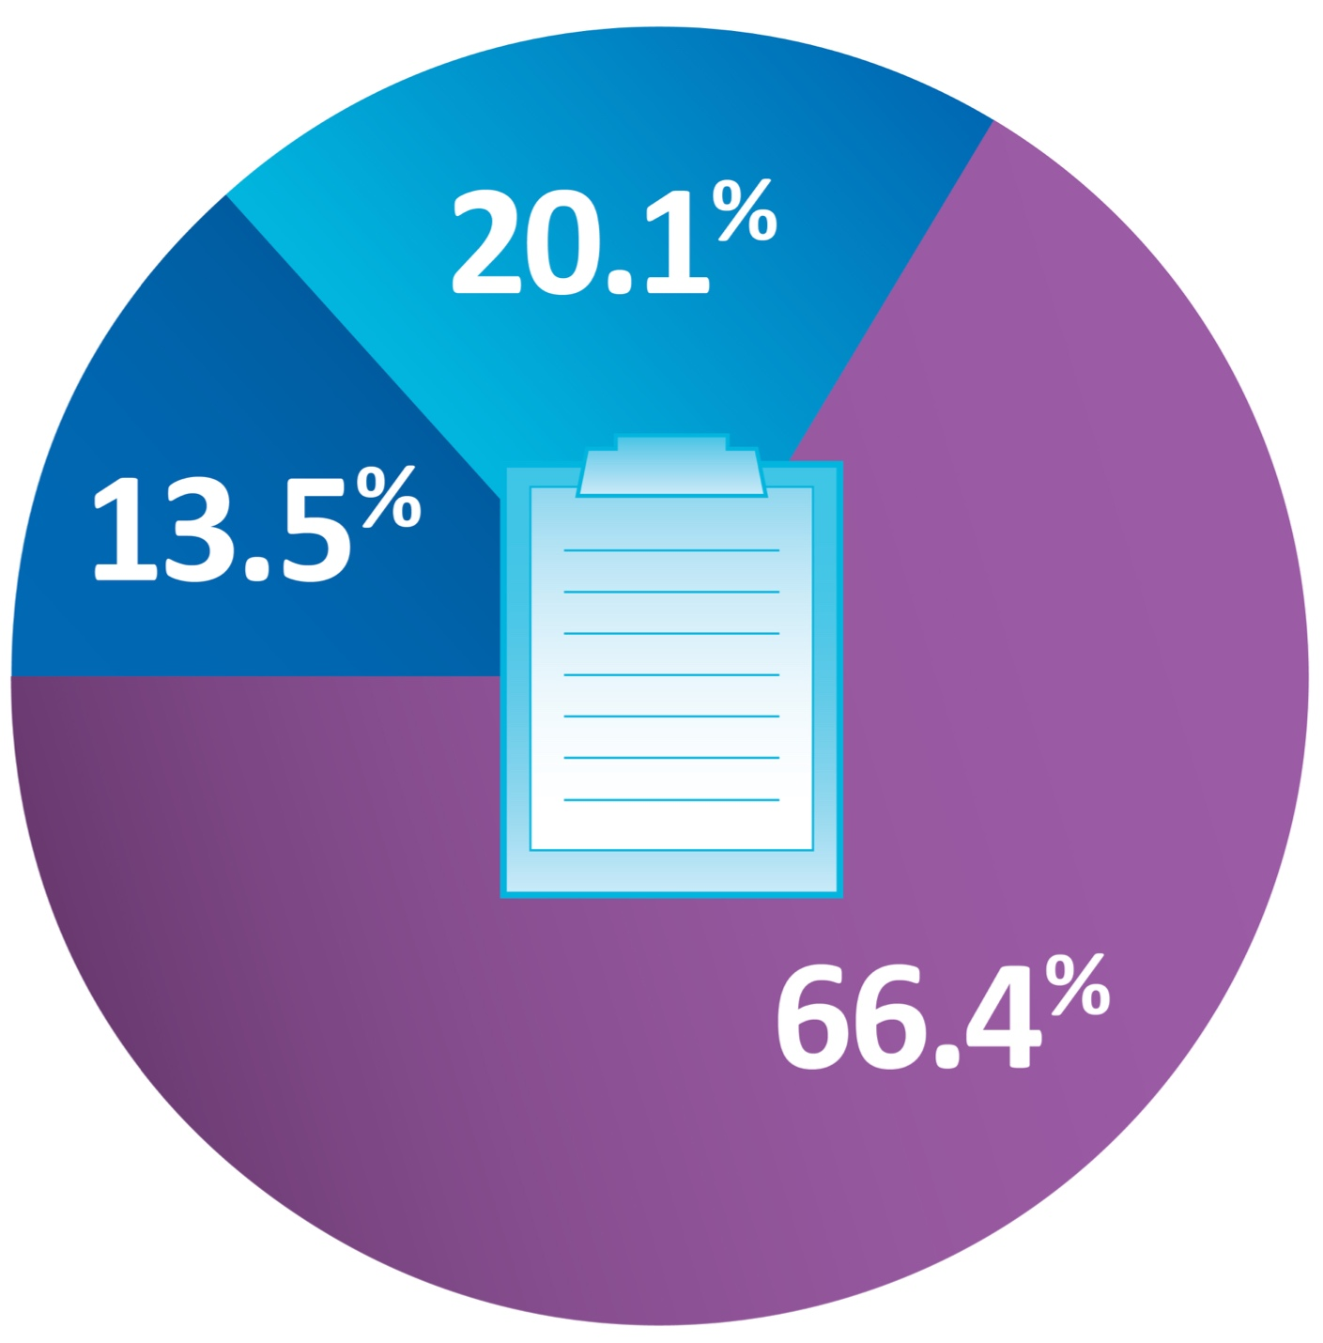
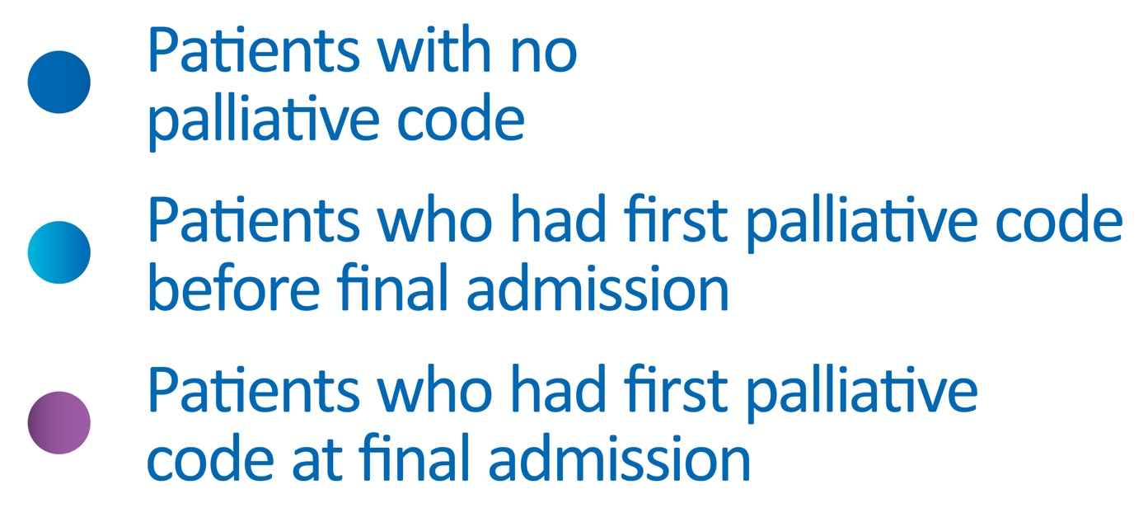
Palliative care designation for people who died of cancer in an acute-care hospital, Canada − 2014−15 combined
Data include all provinces and territories except QC.
Data source: Canadian Institute for Health Information, Discharge Abstract Database.

Slide 4
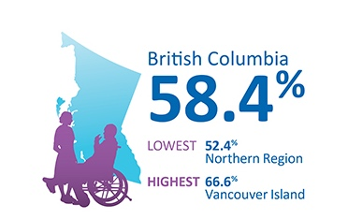
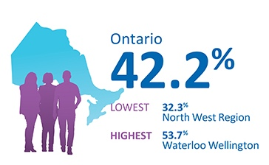
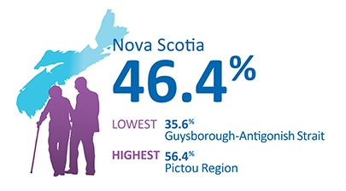
Palliative home care visits from a nurse or personal support worker in the last 6 months of life − 2004−09 combined
Data source: © 2015 American Society of Clinical Oncology.
Reprinted with permission. All rights reserved. Barbera, L et al: J Oncol Pract (Quality Indicators of End-of-Life Care in Patients with Cancer: What Rate Is Right?). Vol. 11(3), 2015: 279-287.

Slide 5
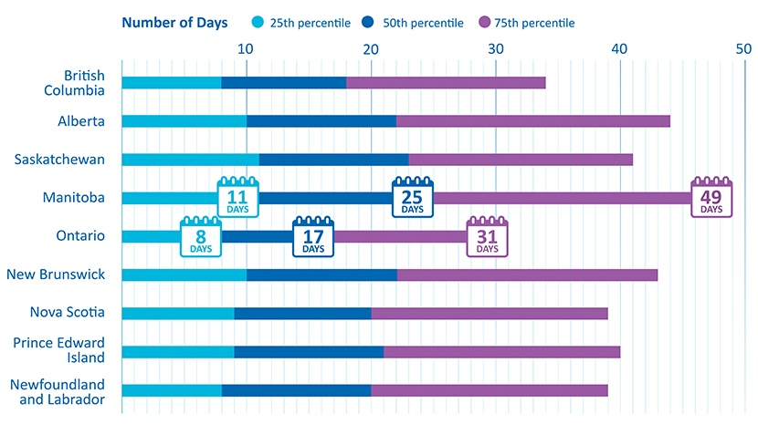
Cumulative length of stay in acute-care hospitals in the last 6 months of life, by province − 2014−15 combined
QC and territories: Data not available.
Acute-care hospital deaths included adults 18+ discharged in fiscal years 2014/15 and 2015/16.
MB, NS and PE have palliative care units within some acute-care hospitals so the cumulative length of stay may appear higher than other provinces.
Data source: Canadian Institute for Health Information, Discharge Abstract Database.

Slide 6
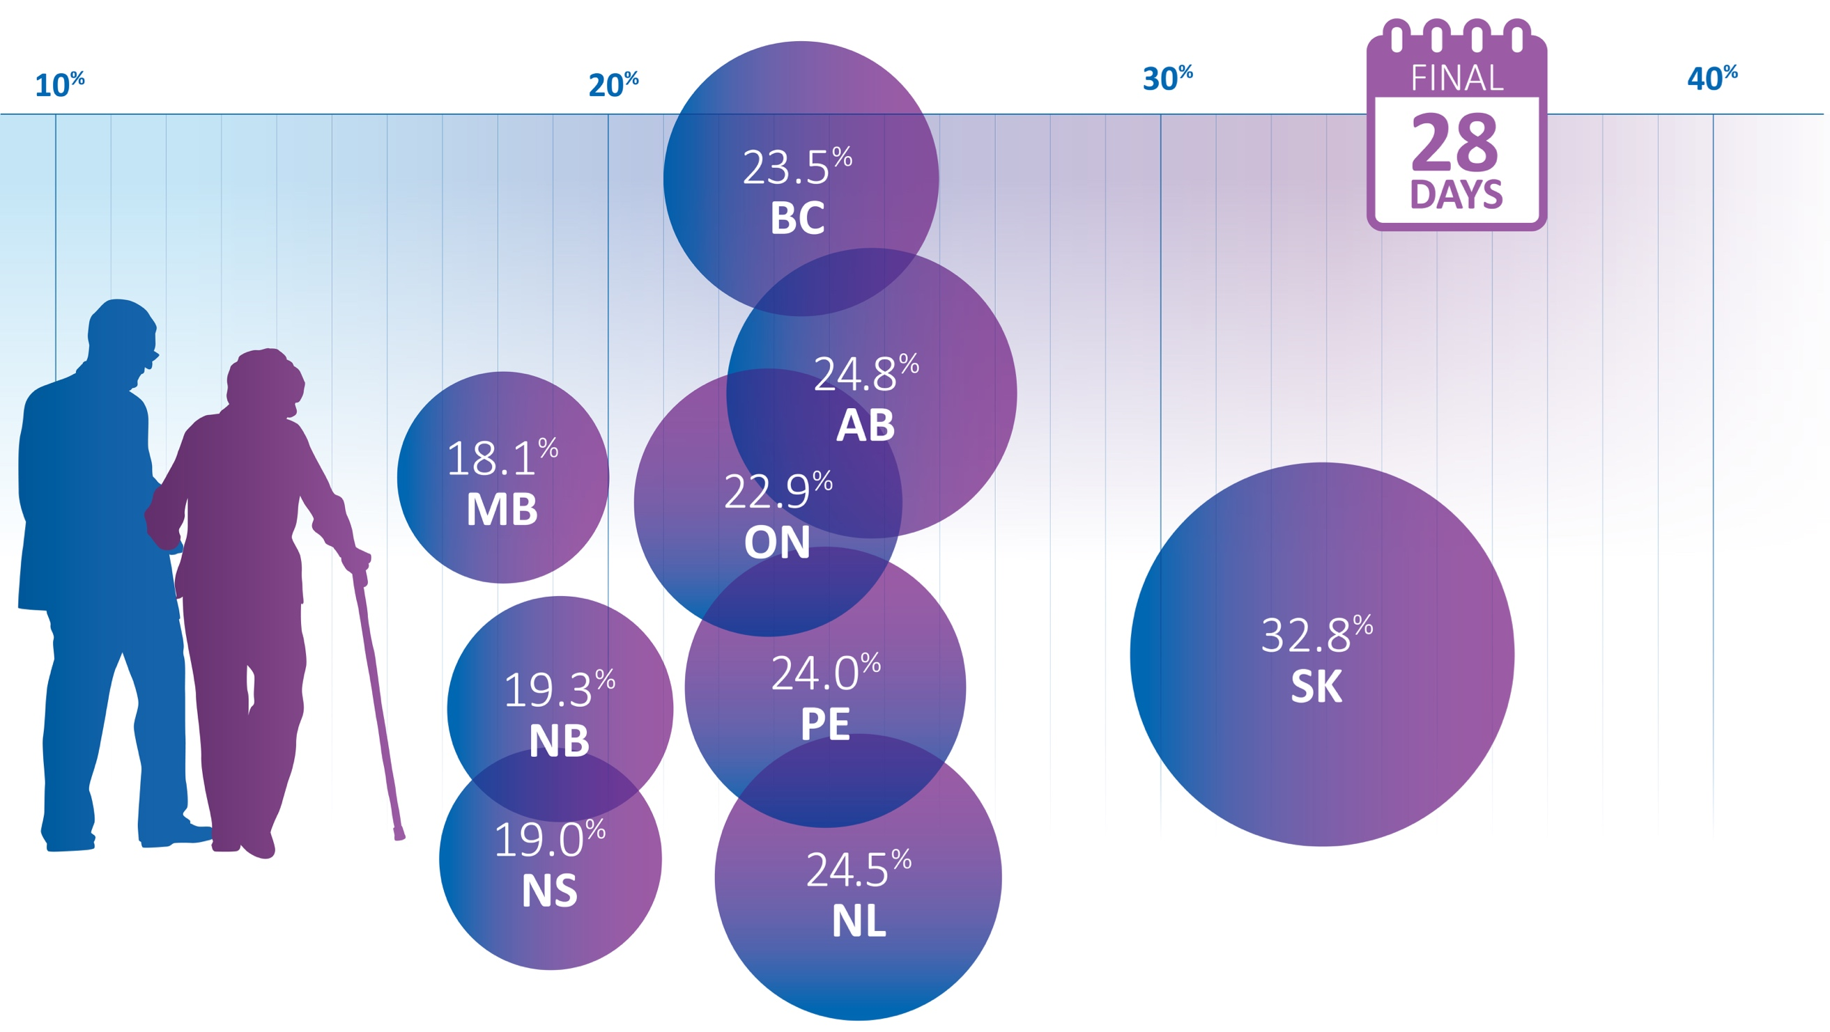
Two or more admissions to acute-care hospitals in the last 28 days of life, by province − 2014−15 combined
QC and territories: Data not available. Acute-care hospital deaths included adults 18+ discharged in fiscal years 2014/15 and 2015/16.
Data source: Canadian Institute for Health Information, Discharge Abstract Database.

Slide 7
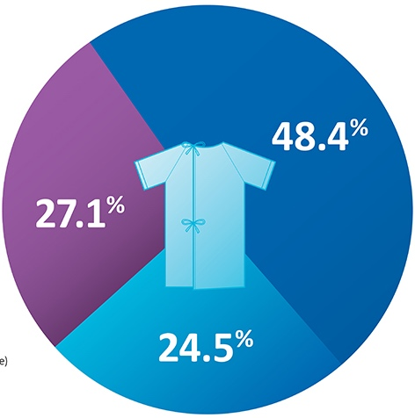
Emergency department visits in the last 28 days of life, Ontario and Alberta combined − 2014−15 combined
Data include only ON and AB patients (where comprehensive emergency department data are available) who died with a cancer diagnosis in acute-care hospitals.
“No visits” includes cancer patients already admitted to hospital 28 days before death. Data source: Canadian Institute for Health Information, Discharge Abstract Database, 2014/15 and 2015/16; National Ambulatory Care Reporting System, 2013/14 to 2015/16.

Slide 8
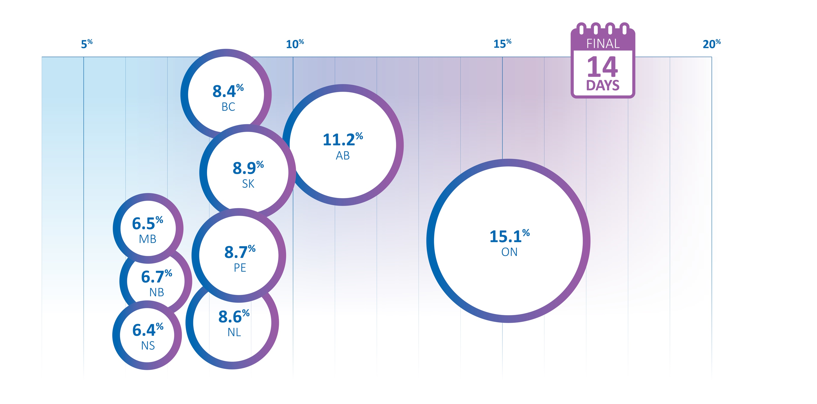
Admissions to an intensive care unit in the last 14 days of life, by province −2014−15 combined
QC and territories: Data not available.
Data on intensive care unit admissions include only facilities that report ICU data. Acute-care hospital deaths include adults aged 18+ discharged in fiscal years 2014/15 and 2015/16.
Data source: Canadian Institute for Health Information, Discharge Abstract Database.

Slide 9
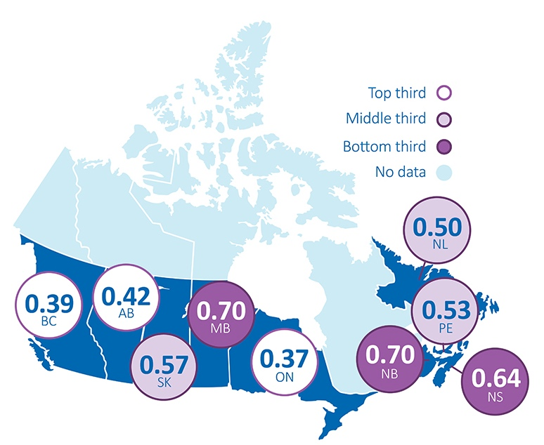
Cancer deaths in acute-care hospitals, by province − 2014−15 combined
Data presented are ratios of the number of cancer deaths in acute-care hospitals to the projected cancer mortality cases.
Projected mortality cases included all cancer deaths aged 0+ in 2014 and 2015.
Acute-care hospital deaths included adults 18+ discharged in fiscal years 2014/15 and 2015/16. Number of cancer deaths in acute-care hospitals = 48,987.
QC and territories: Data not available.
Data source: Canadian Institute for Health Information, Discharge Abstract Database; Canadian Cancer Society, Canadian Cancer Statistics.

Slide 10
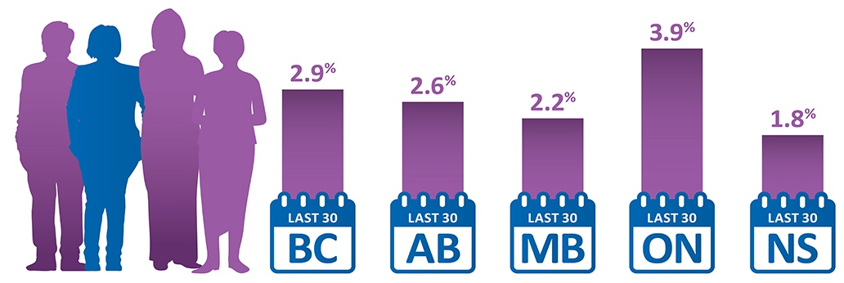
Cancer patients starting a new chemotherapy regimen† in the last 30 days of life, by province − two most recent death years
†AB, MB and ON included oral chemotherapy. In MB, data on oral chemotherapy were not complete in the cancer registry, but have been included if available. NS estimate is conservative since oral chemotherapy data were not available and patients with hematological cancers were excluded from the analysis. MB: data include 2011–12 death years combined. ON: data include 2012 death year only. Data for combined years cannot be calculated because of suppression. All other provinces include 2013–14 death years. Data not available for SK, QC, NB, PE, NL and the territories.
Chemotherapy near the end of life may be warranted in some cases. The data may also include patients without advanced disease who received adjuvant chemotherapy appropriately but died of complications (e.g., toxicity of chemotherapy) shortly after.
Data source: Provincial cancer agencies and programs.

Slide 11
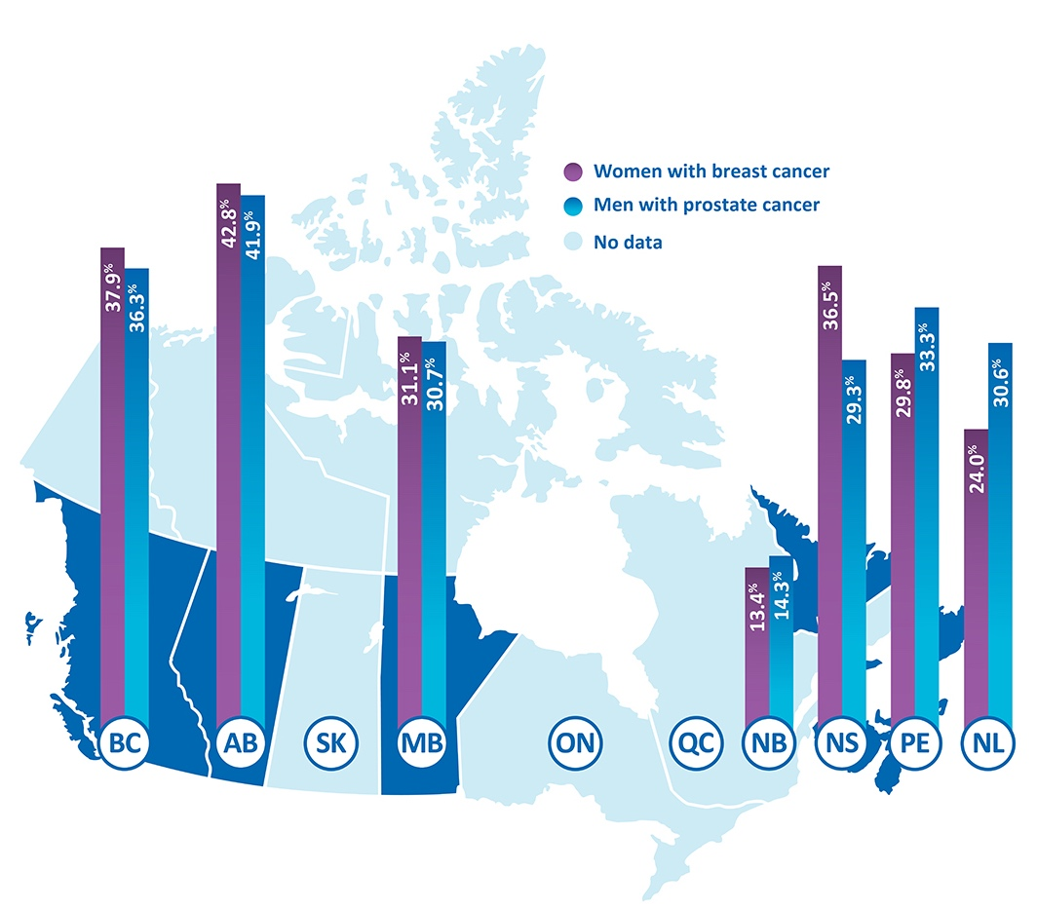
Palliative radiation therapy in the last year of life, by province − two most recent death years
Data not available for SK, ON, QC and the territories. MB and NL: Data include 2011–12 death years combined. All other provinces include 2012–13 death years.
NB: 2011 and 2012 radiation therapy data may be incomplete.
NL: 2011 radiation therapy data may be incomplete.
Palliative care intent is unknown.
Data source: Provincial cancer agencies and programs.

Slide 12
Limitations to measuring and reporting

Slide 13
Acute-care hospitalization near the end of life

Slide 14
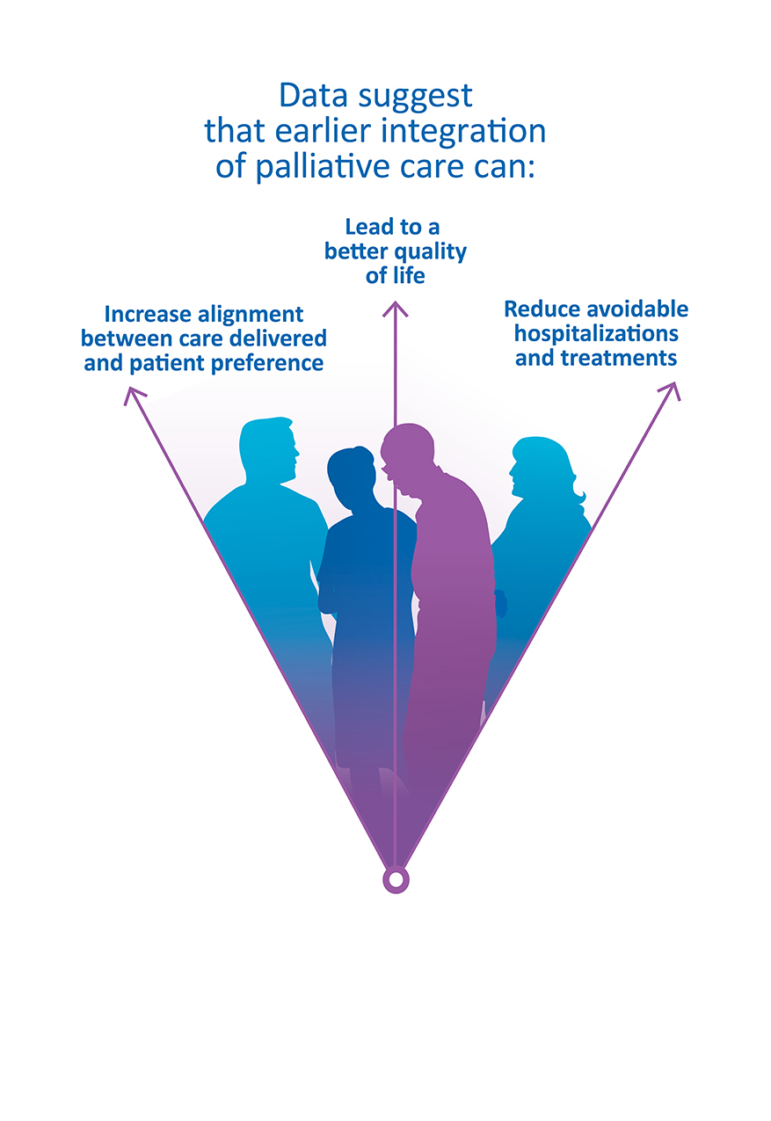

Slide 15
Priority areas in palliative and end-of-life care

Slide 16
Priority areas in palliative and end-of-life care

Slide 17
Priority areas in palliative and end-of-life care

Slide 18
Priority areas in palliative and end-of-life care

