Slide 1
Monitoring and Evaluation of Colorectal Cancer Screening Quality Indicators
Link to report:
https://www.partnershipagainstcancer.ca/topics/colorectal-indicators-2017-2018/
Suggested citation: Canadian Partnership Against Cancer. Monitoring and Evaluation of Colorectal Cancer Screening Quality Indicators. Toronto: Canadian Partnership Against Cancer; 2021.
October 2021

Slide 2
Key Statistics

Slide 3
The Burden of Colorectal Cancer in Canada
Notes:
Source: https://cdn.cancer.ca/-/media/files/research/cancer-statistics/2019-statistics/canadian-cancer-statistics-2019-en.pdf

Slide 4
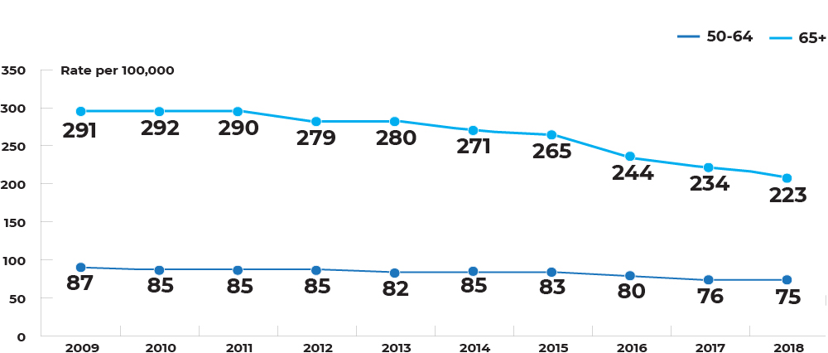
Canada age-standardized incidence rate by age (50-64 and 65+), 2009-2018
Notes:
Data includes all jurisdictions except Quebec.

Slide 5
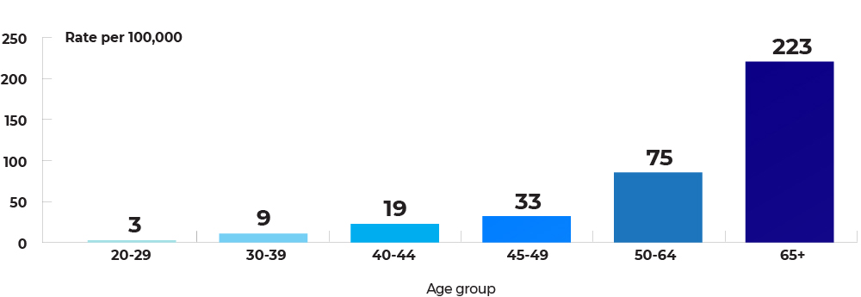
Canada age-standardized incidence rate by age, both sexes, 2018
Notes:
Data includes all jurisdictions except Quebec.

Slide 6
Participation rate
Screen-eligible population-based program participation rate
Screening program participation rate (among those invited to screen)
Percentage overdue for colorectal cancer screening

Slide 7
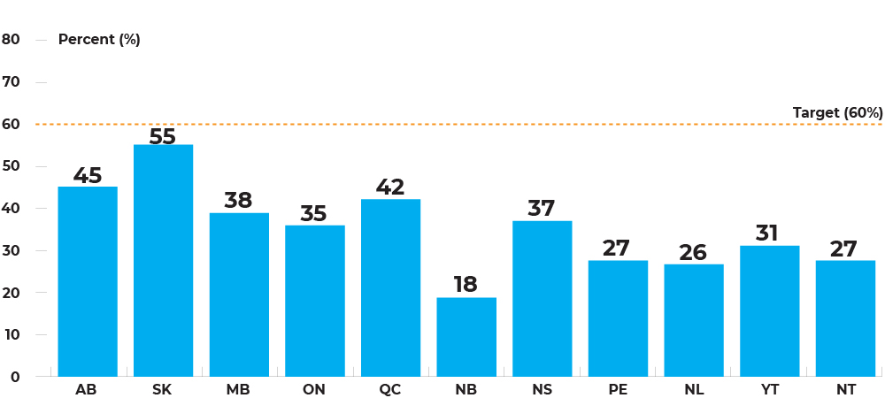
Population-based participation rates for fecal tests (in 30 months) among individuals, by jurisdiction, January 1, 2017 – June 30, 2019
Notes:
Data is not available for BC and NU.
SK: Opportunistic screening is included in this analysis.
MB: Data includes program FOBTs that had a successful result and non-program FOBTs where the result is unknown and are assumed to be successful. The numerator includes a subset of fecal tests completed in the province (those for which data is available).
ON: Individuals were considered screen eligible if they were 50-74 years old without a prior colorectal cancer or prior total colectomy or those who have not had colonoscopy and/or flex sigmoidoscopy within 10 years before Jan 1, 2017. 'Successful FTs' contains 'successful positive' and 'successful negative' results as well as 'unknown' results identified through the OHIP claims database.
QC: Data reflects opportunistic screening only as the screening program was not implemented yet. Source of the screen-eligible denominator is the population projections of 2011-2036 (series produced in November 2014) by the Institut de la statistique du Québec.
NB: The colon cancer screening program was not fully implemented province-wide during this reporting period.
NL: The screening program has a self/provider-based referral system.
YT: Screen eligible population for each age group is the average population of 2017 and 2018from the Yukon Bureau of Statistics.
NT: Screen-eligible denominator is the July 2018 population estimates from NWT Bureau of Statistics.
Data source: Provincial and Territorial Cancer Agencies and Programs.

Slide 8
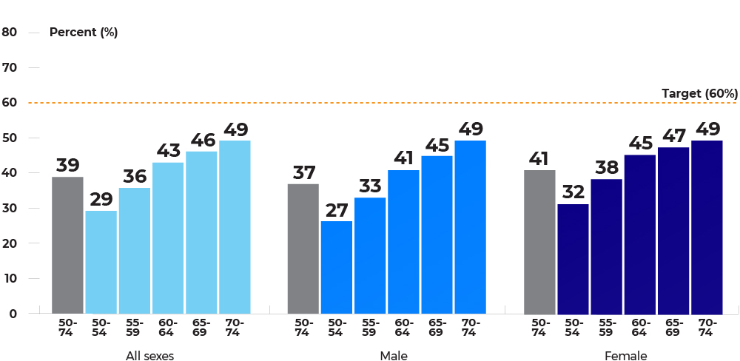
Population-based participation rates for fecal tests (in 30 months) by age group and sex, jurisdictions combined, January 1, 2017 – June 30, 2019
Notes:
Data include AB, SK, MB, ON, QC, NB, NS, PE, NL, YT and NT.
Data source: Provincial and Territorial Cancer Agencies and Programs.

Slide 9
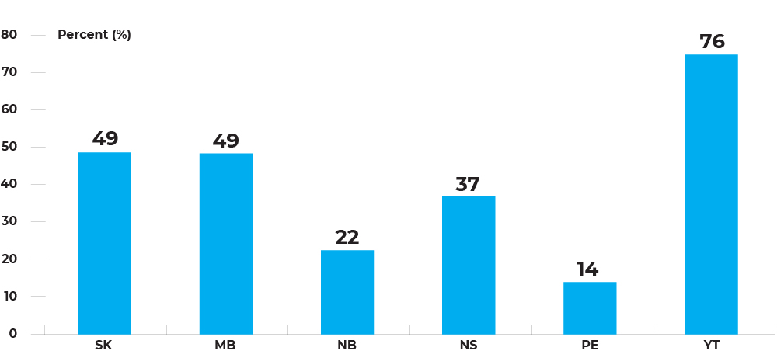
Invitation-based participation rates for fecal tests (in 30 months) among individuals, by jurisdiction, January 1, 2017 – December 31, 2018
Notes:
Data is not available for BC, AB, ON, QC, NL, NT and NU.
MB: Age is calculated at the date of the first successful FOBT analyzed in the 30-month time period. For individuals with no successful FOBT in the 30-month time period, age is calculated at the date the first invitation was mailed within the 2-year time period.
NB: The colon cancer screening program was not fully implemented province-wide during this reporting period.
PE: Population-based invitation in place. The invitation addresses Islanders who do not have a FIT screening history and are new to PEI (age 50 to 74) or recently turned 50, 55, 60, 65, or 70. About 18% of mail invitations are returned to the program due to an invalid address.
YT: There is no population wide invitation process due to available capacity. The numbers of invited males and females from Jan 1, 2017 to Dec 31, 2018 are estimated to be higher, meaning health care providers invited more people to the program but were not captured successfully resulting in a higher participation rate.
Data source: Provincial and Territorial Cancer Agencies and Programs.

Slide 10
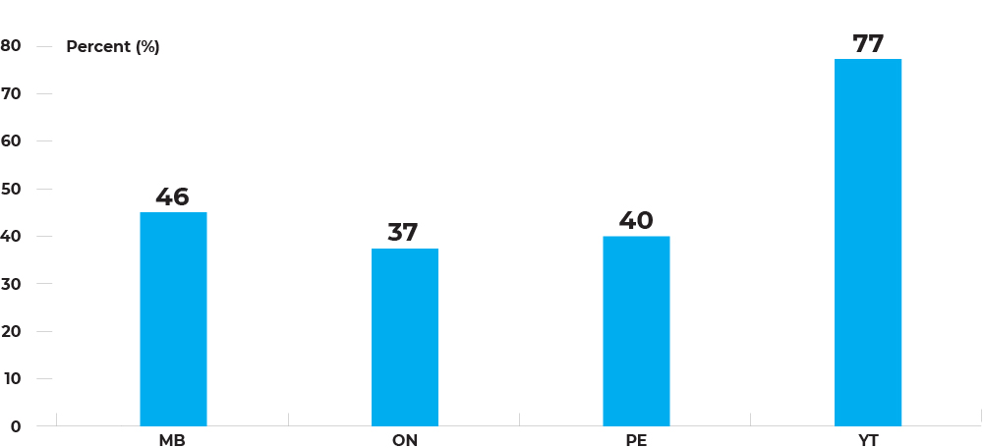
Percentage of overdue for colorectal cancer screening among individuals aged 50-74, by jurisdiction, 2018
Notes:
Data is not available for BC, AB, SK, QC, NB, NS, NL, NT and NU.
MB: An individual was considered ineligible and was excluded from the calculation if any of the following occurred: (1) A death date prior to the end of 2018; (2) Cessation of provincial health coverage prior to the end of 2018; (3) A cancer diagnosis prior to the end of 2018; (4) Their demographic record did not exist in the ColonCheck registry until after December 31, 2018; (5) They opted out of participation in ColonCheck.
ON: Individuals with a missing/invalid Health Insurance Number, date of birth or non-Ontario residents are excluded. Individuals were considered 'Screen eligible' if they were 50-74 as of Jan 1, of 2018, with no colorectal cancer and total colectomy prior to Jan 1, 2018.
PE: Data is for 2019. An individual was considered overdue if they did not have a FIT test in the previous two and a half years, or a colonoscopy or sigmoidoscopy in the previous 10 years. Individuals with colorectal cancers were removed. Data may contain diagnostic tests for symptomatic people.
YT: Eligible population is estimated from the Yukon Bureau of Statistics December 31, 2018. Overdue Population is the eligible population counts minus the number of patients who had a FIT test in the previous 2 years AND those who had a colonoscopy or sigmoidoscopy in the last 10 years.
Data source: Provincial and Territorial Cancer Agencies and Programs.

Slide 11
Follow-up colonoscopy rate

Slide 12
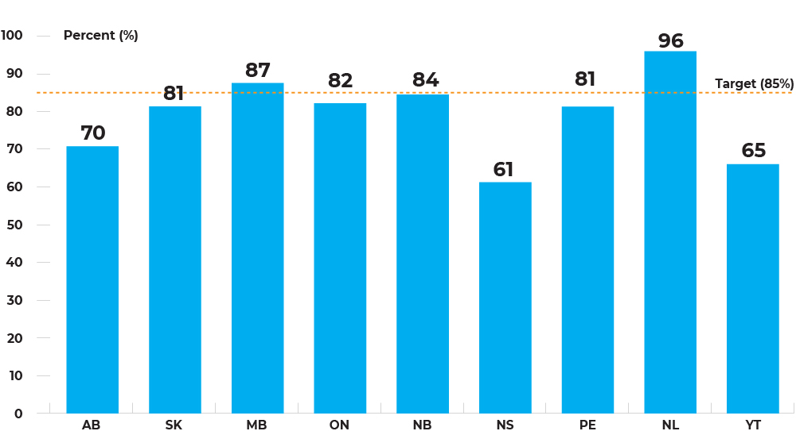
Percentage of colonoscopy uptake within 180 days of abnormal fecal tests among individuals aged 50-74, by jurisdiction, screening year 2017 to 2018
Notes:
Data is not available for BC, QC, NT and NU.
AB: FT data were extracted from Alberta Colorectal Cancer Screening Program database. Colonoscopy data were extracted from Alberta NACRS/DAD and Physician Claims database.
SK: Sigmoidoscopy is not included in this analysis. Opportunistic screening is included in this analysis.
ON: Includes individuals with an abnormal fecal test between Jan 2017 and June 2019. Colonoscopy was counted within 183 days of an abnormal fecal test result.
NB: The colon cancer screening program was not fully implemented province-wide during this reporting period. This indicator includes individuals who opted out of the program/colonoscopy.
Data source: Provincial and Territorial Cancer Agencies and Programs.

Slide 13
Wait times

Slide 14
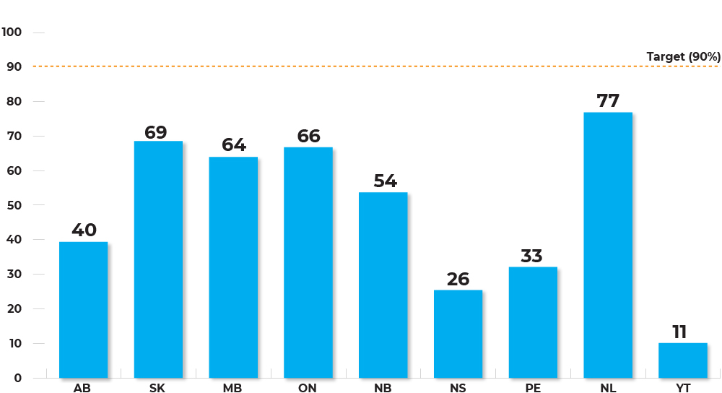
Percentage of people who have colonoscopies performed within 60 days of abnormal fecal tests among individuals aged 50-74, by jurisdiction, screening year 2017 – 2018
Notes:
Data is not available for BC, QC, NT and NU.
AB: FT data were extracted from Alberta Colorectal Cancer Screening Program database. Colonoscopy data were extracted from Alberta NACRS/DAD and Physician Claims database.
SK: Sigmoidoscopy is not included in this analysis. Opportunistic screening is included in this analysis.
MB: The denominator includes only the colonoscopies done within the screening program, while the numerator includes colonoscopies done within or outside of the screening program.
ON: Includes individuals with an abnormal fecal test between Jan 2017 and June 2019. Colonoscopy within 60 days was counted among those who had a colonoscopy within 183 days of an abnormal fecal test result. .
NB: The colon cancer screening program was not fully implemented province-wide during this reporting period. This indicator includes individuals who opted out of the program/colonoscopy.
Data source: Provincial and Territorial Cancer Agencies and Programs.

Slide 15
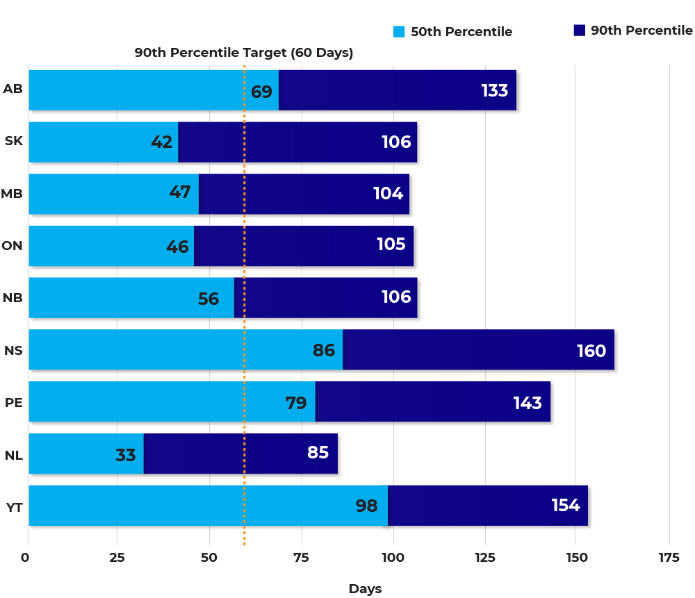
Wait time (days) from abnormal fecal test to colonoscopy among individuals aged 50-74, by jurisdiction, screening year 2017 – 2018
Notes:
Data is not available for BC, QC, NT and NU.
AB: FT data were extracted from Alberta Colorectal Cancer Screening Program database. Colonoscopy data were extracted from Alberta NACRS/DAD and Physician Claim database.
SK: Sigmoidoscopy is not included in this analysis. Opportunistic screening is included in this analysis.
MB: Data included colonoscopies done within or outside of the screening program.
ON: Includes individuals with an abnormal fecal test between Jan 2017 and June 2019. Colonoscopy was counted within 183 days of an abnormal fecal test result.
NB: The colon cancer screening program was not fully implemented province-wide during this reporting period. This indicator includes individuals who opted out of the program/colonoscopy. Data source: Provincial and Territorial Cancer Agencies and Programs.

Slide 16
Invasive CRC rate

Slide 17
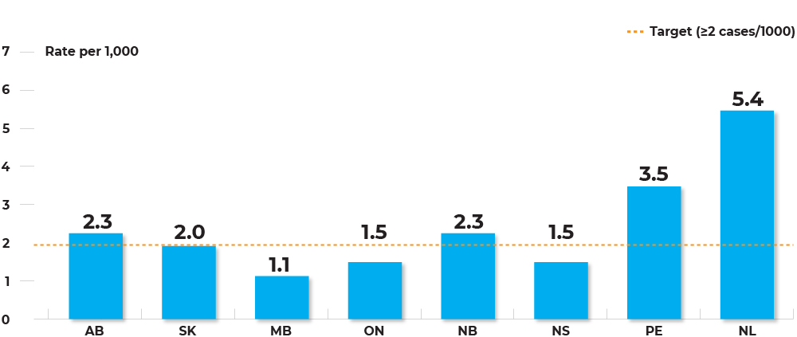
Detection rate (per 1,000) of invasive colorectal cancers through programmatic screening among individuals aged 50-74, by jurisdiction, screening year 2016 – 2017
Notes:
Data is not available for BC, QC, YT, NT and NU.
SK: Opportunistic screening is included in this analysis.
ON: Invasive colorectal cancer was identified as: ICD-O-3 codes C18.0, C18.2-C18.9, C19.9, C20.9, , a morphology indicative of colorectal cancer, microscopically confirmed with a path report. Excluding histology codes: 9590-9989, 8240-8246, 8248-8249. Data for stage 0 were not available.
NL: Data for stage 0 were not available.
Data source: Provincial and Territorial Cancer Agencies and Programs.

Slide 18
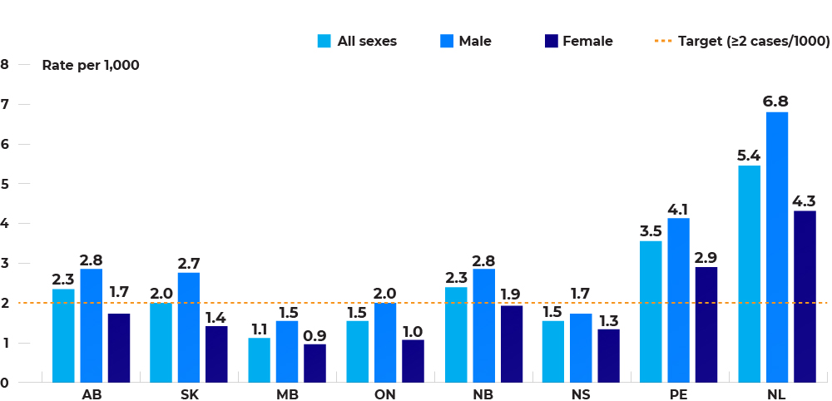
Detection rate (per 1,000) of invasive colorectal cancers through programmatic screening among individuals aged 50-74, by jurisdiction and sex, screening year 2016 – 2017
Notes:
Data is not available for BC, QC, YT, NT and NU.
SK: Opportunistic screening is included in this analysis.
ON: Invasive colorectal cancer was identified as: ICD-O-3 codes C18.0, C18.2-C18.9, C19.9, C20.9, a morphology indicative of colorectal cancer, microscopically confirmed with a path report. Excluding histology codes: 9590-9989, 8240-8246, 8248-8249
Data source: Provincial and Territorial Cancer Agencies and Programs.

Slide 19
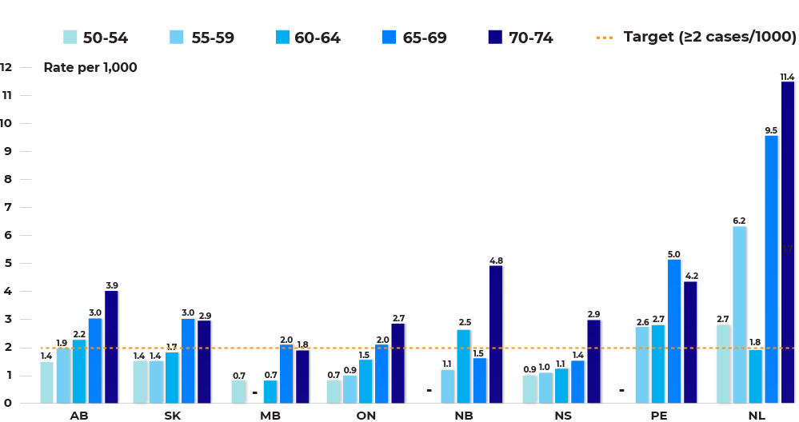
Detection rate (per 1,000) of invasive colorectal cancers through programmatic screening among individuals aged 50-74, by jurisdiction and age group, screening year 2016 – 2017
Notes:
Data not available for BC, QC, YT, NT and NU.
SK: Opportunistic screening is included in this analysis.
MB: data for age group 60-64 were combined with data for age group 55-59.
ON: Invasive colorectal cancer was identified as: ICD-O-3 codes C18.0, C18.2-C18.9, C19.9, C20.9, a morphology indicative of colorectal cancer, microscopically confirmed with a path report. Excluding histology codes: 9590-9989, 8240-8246, 8248-8249
NB: Data for age group 55-59 were combined with data for age group 50-54.
PE: Data for age group 55-59 were combined with data for age group 50-54.
Data source: Provincial and Territorial Cancer Agencies and Programs.

Slide 20
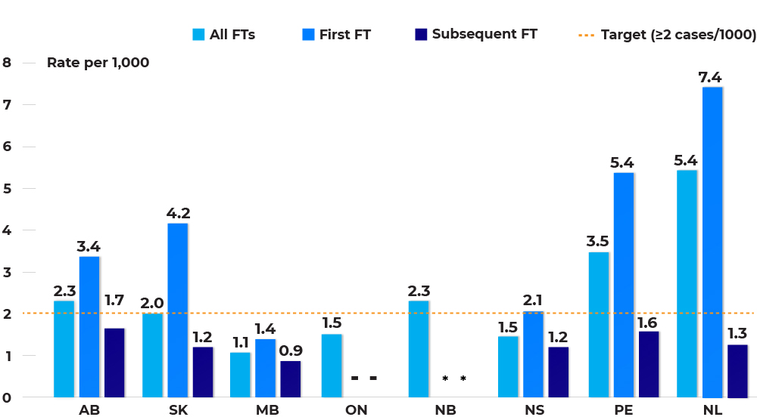
Detection rate (per 1,000) of invasive colorectal cancers through programmatic screening among individuals aged 50-74, by jurisdiction and first or subsequent fecal test, screening year 2016 – 2017
Notes:
Data not available for BC, QC, YT, NT and NU
.
* : Data suppressed due to small numbers SK: Opportunistic screening is included in this analysis.
ON: Invasive colorectal cancer was identified as: ICD-O-3 codes C18.0, C18.2-C18.9, C19.9, C20.9, a morphology indicative of colorectal cancer, microscopically confirmed with a path report. Excluding histology codes: 9590-9989, 8240-8246, 8248-8249
Data source: Provincial and Territorial Cancer Agencies and Programs.

Slide 21
Stage distribution

Slide 22
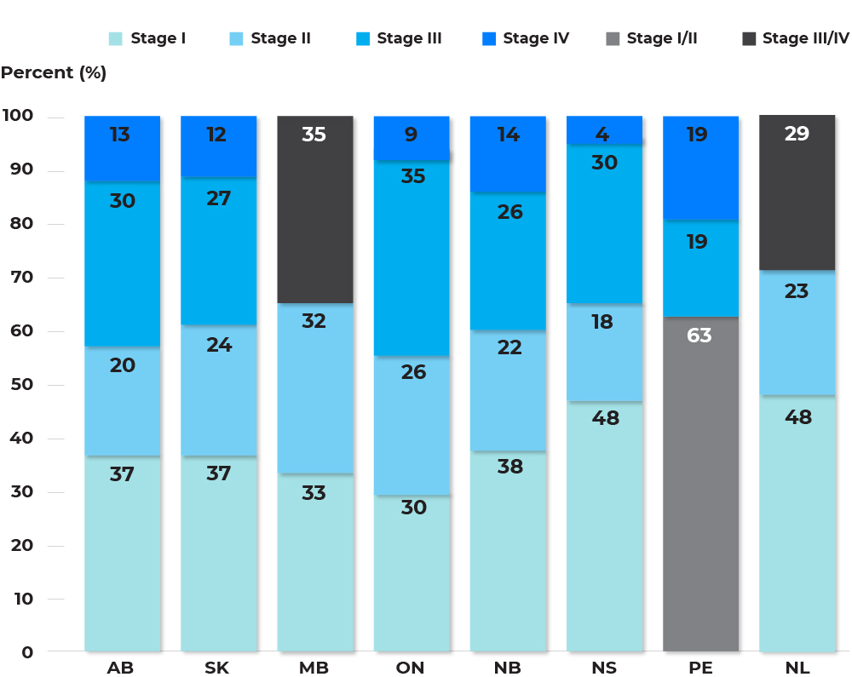
Distribution of stage for invasive colorectal cancers detected through programmatic screening among individuals aged 50-74, by jurisdiction, screening year 2016 – 2017
Notes:
Data not available for BC, QC, YT, NT and NU.
AB: Cancer stage groups were defined by AJCC 7th for 2016-2017. From 2018 and onward, cancer stage groups were defined by AJCC 8th.
SK: Opportunistic screening is included in this analysis.
MB: Data for Stage III and Stage IV were combined due to small number. Cases diagnosed prior to 2018 were staged using AJCC7, cases diagnosed in 2018 onwards were staged using AJCC8. ON: Staging data based on date of diagnosis.
PE: Data for Stage I and Stage II were combined due to small numbers.
NL: Data for Stage III and Stage IV were combined due to small numbers.
Data source: Provincial and Territorial Cancer Agencies and Programs.

Slide 23
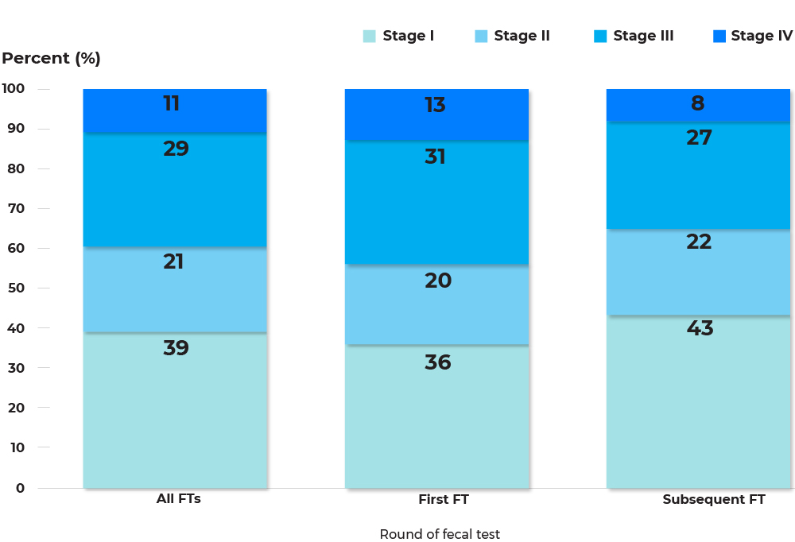
Distribution of stage for invasive colorectal cancers detected through programmatic screening among individuals aged 50-74, jurisdictions combined, screening year 2016 – 2017
Notes:
Data include AB, SK, NB, NS, PE and NL.
Some totals are less or more than 100% due to rounding.
Data source: Provincial and Territorial Cancer Agencies and Programs.

Slide 24
Post-colonoscopy hospitalization

Slide 25
Rate (per 1,000) of hospitalization for outpatient colonoscopies, Ontario, by reason for hospitalization, colonoscopies performed from 2017 – 2018
Notes:
ON: Hospitalization due to perforation was calculated based on people admitted to hospital within 7 days of their outpatient colonoscopies among individuals age 18+. Hospitalization due to bleeding was calculated based on people admitted within 14 days of their outpatient colonoscopies among individuals age 50+, where at least 1 polyp(s) was removed in the reporting period.
Data source: Provincial and Territorial Cancer Agencies and Programs.

Slide 26
Interval Cancers
After a negative fecal test
After a negative colonoscopy as a follow-up to a positive fecal test

Slide 27
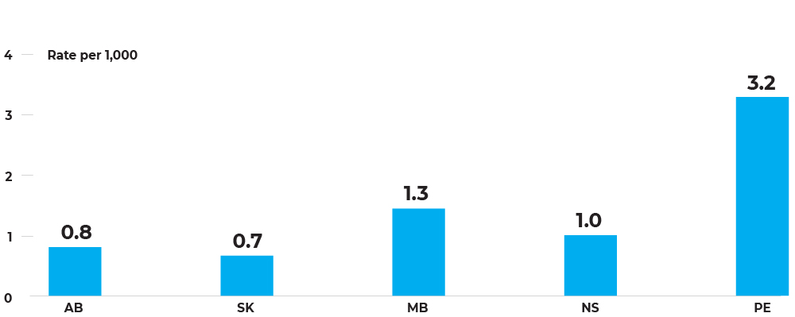
Rate (per 1,000) of interval colorectal cancers within 24 months of fecal tests with normal result among individuals aged 50-74, by jurisdiction, fecal tests from 2014-2015
Notes:
Data not available for BC, ON, QC, NB, NL, YT, NT and NU.
SK: Opportunistic screening is included in this analysis.
MB: Age is calculated at the date of the last negative FT analyzed in 2014-2015.
Data source: Provincial and Territorial Cancer Agencies and Programs.

Slide 28
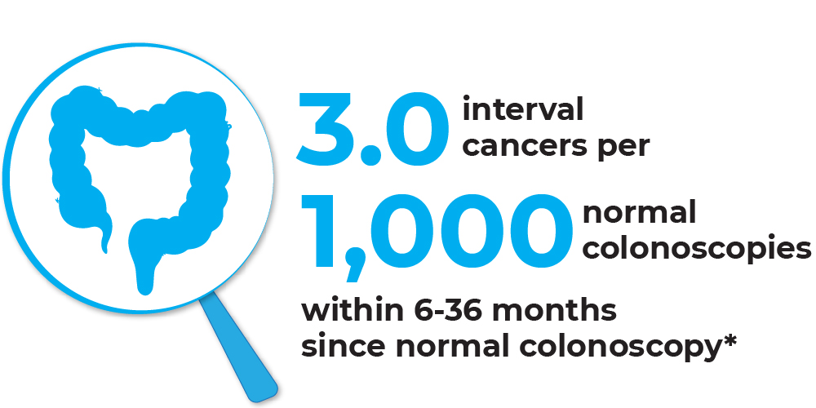
Rate (per 1,000) of interval colorectal cancers within 6-36 months since normal colonoscopy, among individuals aged 50-74, Saskatchewan and Prince Edward Island combined, fecal tests from 2012 – 2013*
Notes:
Data include SK and PE, combined.
Data source: Provincial and Territorial Cancer Agencies and Programs.

