Slide 1
Monitoring and Evaluation of Breast Cancer Screening Quality Indicators
Link to report:
https://www.partnershipagainstcancer.ca/topics/breast-indicators-2018-2021/
Suggested citation: Canadian Partnership Against Cancer. Monitoring and Evaluation of Breast Cancer Screening Quality Indicators. Toronto: Canadian Partnership Against Cancer; 2024
June 2024

Slide 2
Key Statistics

Slide 3
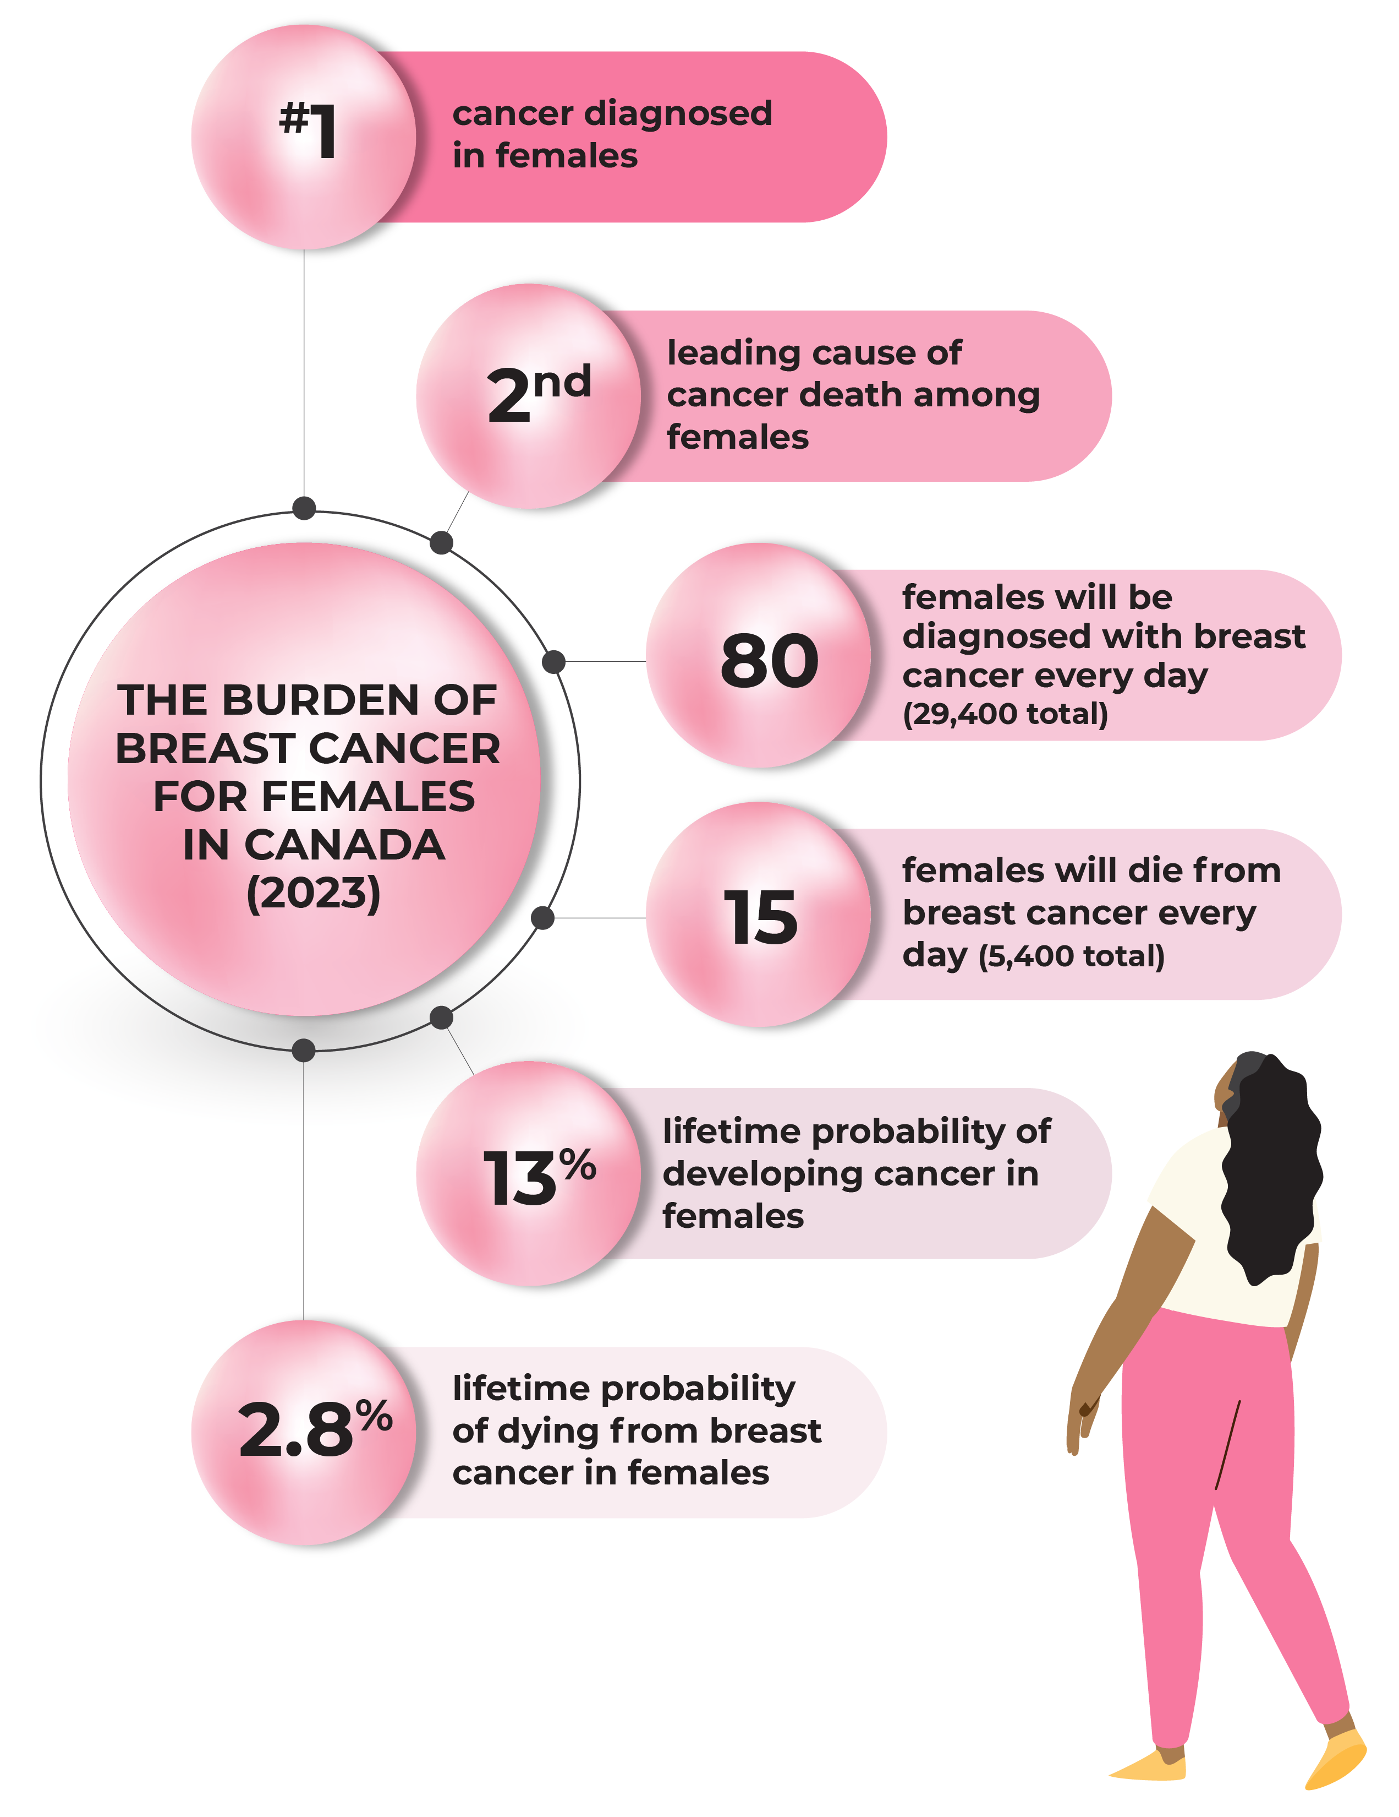
The Burden of Breast Cancer For Females in Canada (2023)
Notes:
Source: 2023pdfen.pdf (cancer.ca)

Slide 4
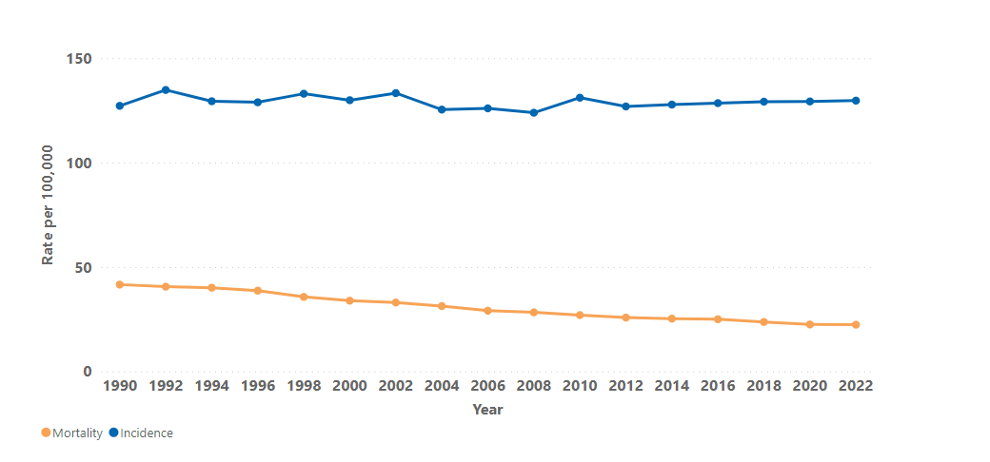
Age-standardized Rate for Incidence and Mortality for Breast Cancer (Female), Canada, 1990 to 2022
Notes:
Footnotes
For the age-standardized incidence rate:
Quebec was excluded for all years; Estimates for 2019 exclude Nova Scotia.
Rates are age-standardized to the 2011 Canadian standard population. Actual incidence data was available until 2019 in each province and territory except Nova Scotia and Quebec. Estimates for 2020 to2022 are projected.
For the age-standardized mortality rate:
Actual mortality data was available until 2020 for all provinces and territories except Yukon, for which data was available to 2016 and inputted from 2017 to 2020.
Rates are age-standardized to the 2011 Canadian standard population. Estimates for 2021 and 2022 were projected based on data up to 2020.
Data Source: Canadian Cancer Statistics 2023

Slide 5
Impact of the COVID-19 on Breast Cancer Screening

Slide 6
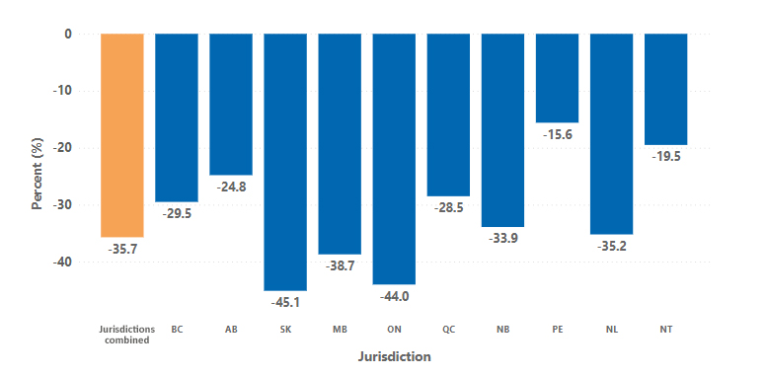
Percentage of change in individuals screened within 12 months for those aged 50-74 between the pre-pandemic and the pandemic era (2019 vs 2020), by jurisdiction
Notes:
Footnotes
Number of screens in 2019 (pre-) and 2020 (pandemic era), for age 50-74 were extracted from Abnormal Call rate.
Jurisdictions combined: data included BC, AB, SK, MB, ON, QC, NB, PE, NL, and NT.
SK: Data included individuals aged 50-69 since individuals aged 70-74 were not routinely invited.
MB: Differences observed may also be attributed to operational changes and limitations that were seen in this reporting period.
QC: Data included individuals aged 50-69 since individuals aged 70-74 were not routinely invited.
NB: Data for 2020 are incomplete.
Data source: Provincial and Territorial Breast Cancer Screening Programs.

Slide 7
Participation Rate

Slide 8
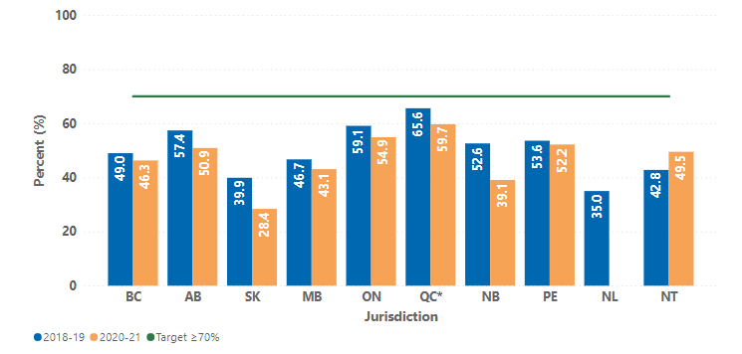
Breast cancer screening participation among individuals aged 50-74, who were screened within a screening mammography program, by jurisdiction and screening period – 2018-19 and 2020-21
Notes:
Footnotes
Data cited as 2018-19 included screens from January 2018 to June 2020 and data cited as 2020-21 included screens from January 2020 to June 2022. For QC*, data cited as 2018-19 included screens from July 2017 to December 2019 and data cited as 2020-21 included screens from July 2018 to December 2020.
SK: Data included individuals aged 50-69 since individuals aged 70-74 were not routinely invited.
MB: Provincial participation was underestimated (by approximately 10-15%), as data reflected BreastCheck program screening mammograms only and did not include screening mammograms done outside of the BreastCheck program.
QC*: Data included individuals aged 50-69 since individuals aged 70-74 were not routinely invited. Data for 2020-21 refers to data from 2019-2020.
NB: The results for the period 2020-21 were underestimated since the data was incomplete.
Data source: Provincial and Territorial Breast Cancer Screening Programs.

Slide 9
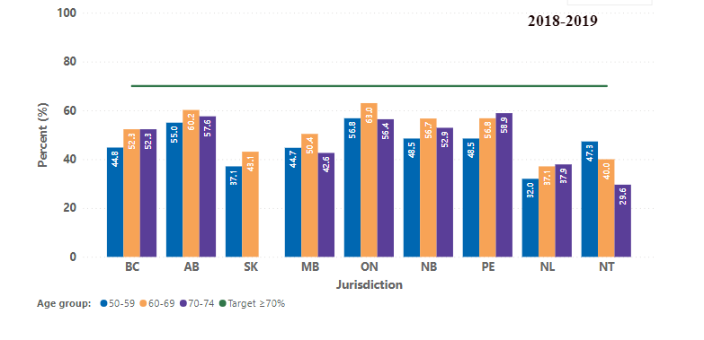
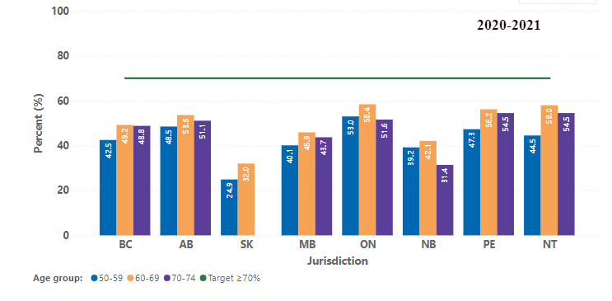
Breast cancer screening participation among individuals aged 50-74, who were screened within a screening mammography program, by jurisdiction and age group – 2018-19 and 2020-21)
Notes:
Footnotes
SK: Data included individuals aged 50-69 since individuals aged 70-74 were not routinely invited.
MB: Provincial participation was underestimated (by approximately 10-15%), as data reflected BreastCheck program screening mammograms only and did not include screening mammograms done outside of the BreastCheck program.
NB: The result for the period 2020-21 was underestimated since the data was incomplete.
Data source: Provincial and Territorial Breast Cancer Screening Programs.

Slide 10
Abnormal Call Rate

Slide 11
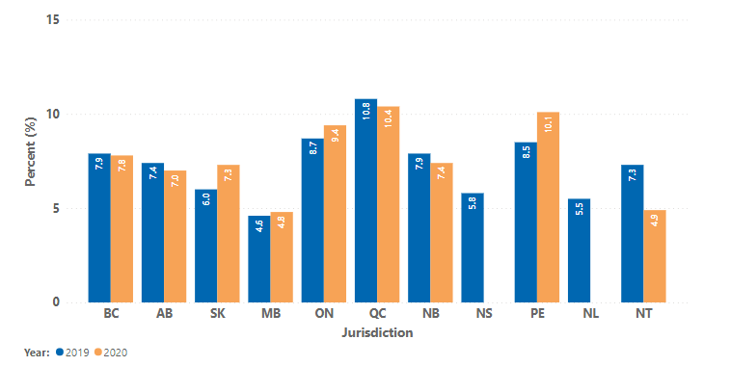
Abnormal call rate among individuals aged 50-74, who were screened within a screening mammography program, by jurisdiction — 2019 and 2020
Notes:
Footnotes
SK: Data included individuals aged 50-69 since individuals aged 70-74 were not routinely invited.
QC: Data included individuals aged 50-69 since individuals aged 70-74 were not routinely invited.
Data source: Provincial and Territorial Breast Cancer Screening Programs.

Slide 12
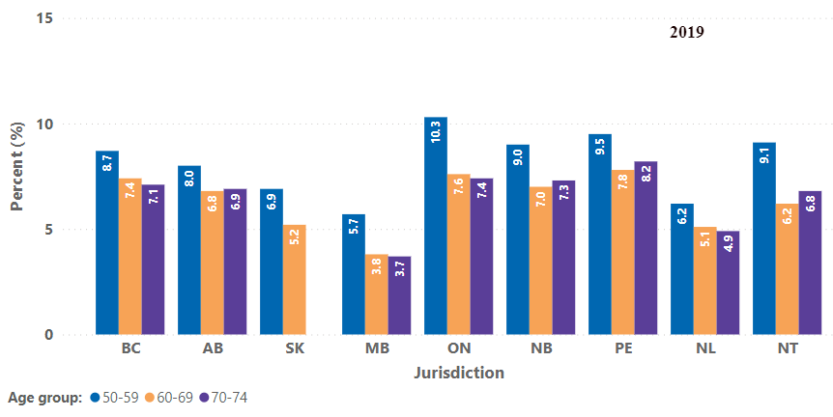
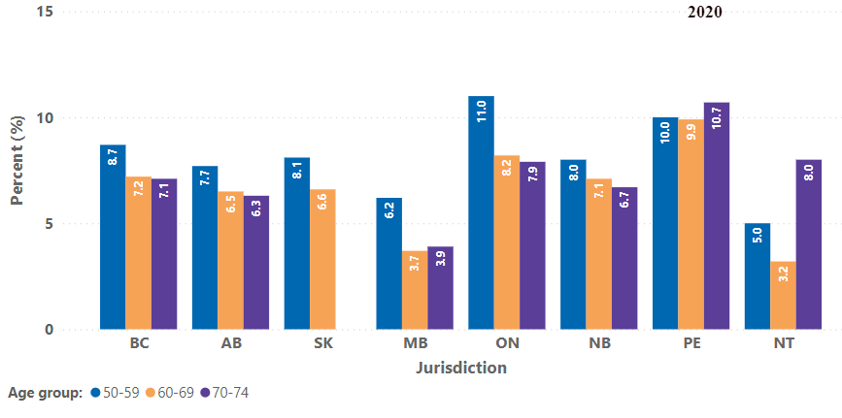
Abnormal call rate among individuals aged 50-74, who were screened within a screening mammography program, by jurisdiction and age group — 2019 and 2020
Notes:
Footnotes
SK: Data included individuals aged 50-69 since individuals aged 70-74 were not routinely invited.
Data source: Provincial breast cancer screening program

Slide 13
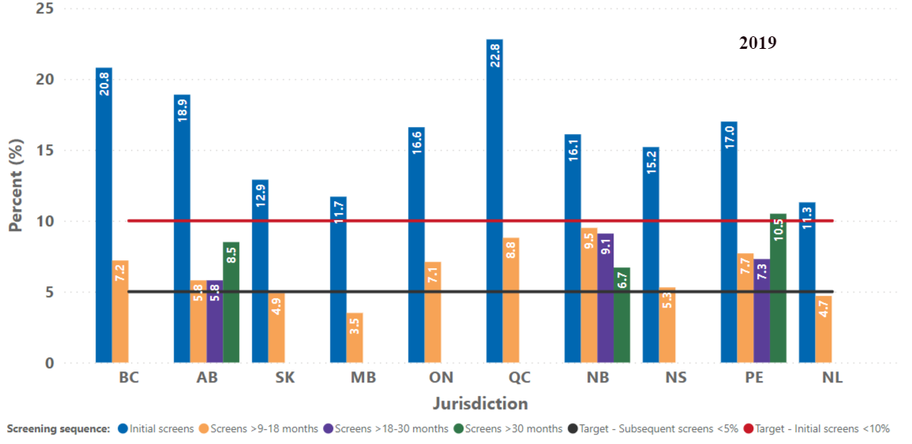
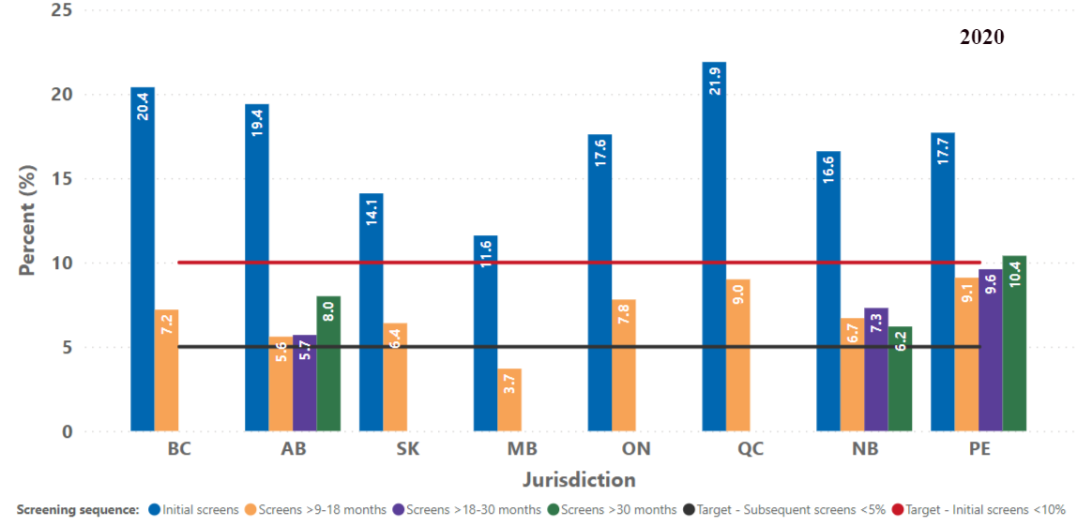
Abnormal call rate among individuals aged 50-74, who were screened within a screening mammography program, by jurisdiction and screening sequence — 2019 to 2020
Notes:
Footnotes
SK: Data included individuals aged 50-69 since individuals aged 70-74 were not routinely invited.
QC: Data included individuals aged 50-69 since individuals aged 70-74 were not routinely invited. Not able to break down the subsequent screens by the specified month interval. All the subsequent screens were combined and presented as “screens > 9 to 18 months”. Subsequent screens in the PQDCS are defined as screens ≥11 months.
BC, SK, MB, ON, NS and NL were not able to break down the subsequent screens by the specified month interval. All the subsequent screens were combined and presented as “screens > 9 to 18 months”.
Data source: Provincial Breast Cancer Screening Programs.

Slide 14
Positive Predictive Value

Slide 15
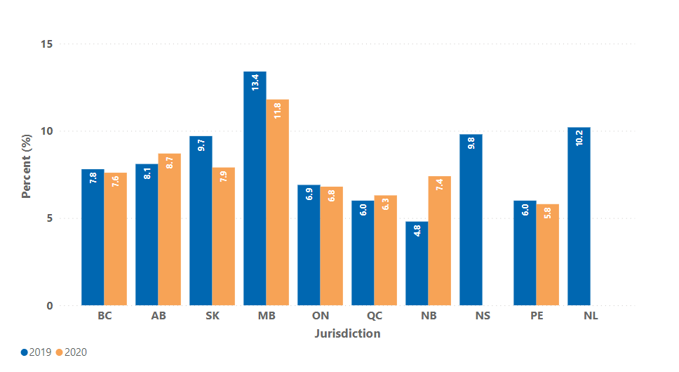
Percentage of individuals (aged 50-74) with abnormal mammograms who were diagnosed with breast cancer, by jurisdiction – 2019 and 2020
Notes:
Footnotes
SK: Data included individuals aged 50-69 since individuals aged 70-74 were not routinely invited. Screens that were lost to follow-up within 6 months of screening were not excluded.
ON: Abnormal screens that were lost to follow-up were excluded, regardless of the 6-month period.
QC: Data included individuals aged 50-69 since individuals aged 70-74 were not routinely invited.
NS, NL: Screens that were lost to follow-up within 6 months of screening were not excluded.
Data source: Provincial Breast Cancer Screening Programs.

Slide 16
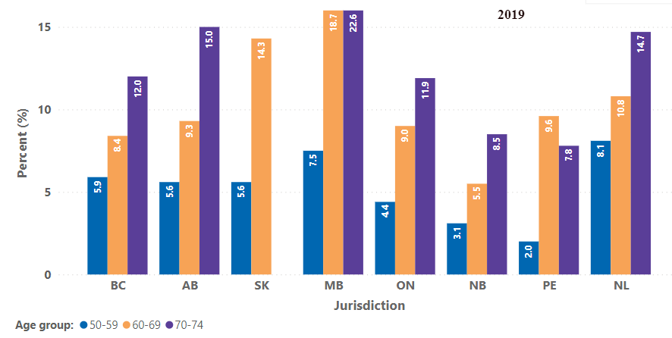
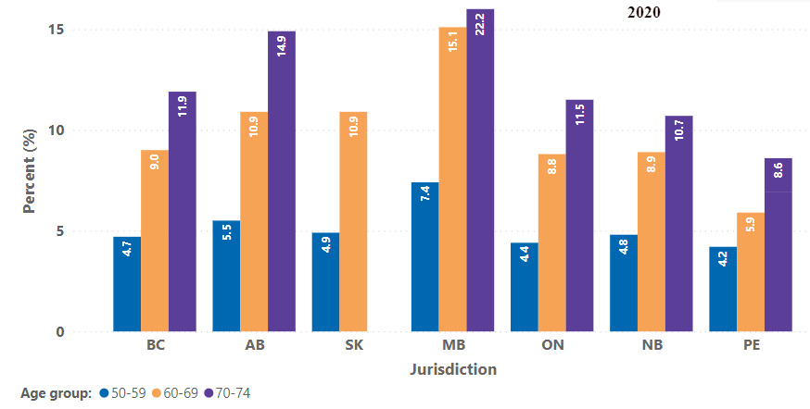
Percentage of individuals (aged 50-74) with abnormal mammograms who were diagnosed with breast cancer, by jurisdiction and age group – 2019 and 2020
Notes:
Footnotes
SK: Data included individuals aged 50-69 since individuals aged 70-74 were not routinely invited. Screens that were lost to follow-up within 6 months of screening were not excluded.
NS, NL: Screens that were lost to follow-up within 6 months of screening were not excluded.
ON: Abnormal screens that were lost to follow-up were excluded, regardless of the 6-month period.
Data source: Provincial Breast Cancer Screening Programs.

Slide 17
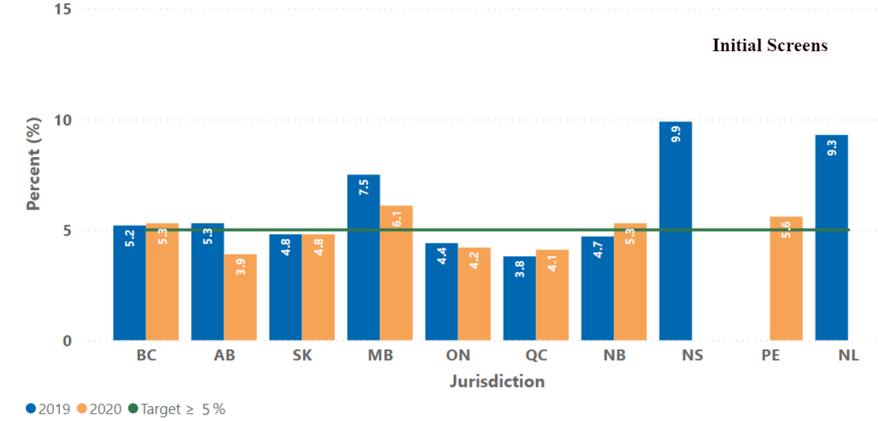
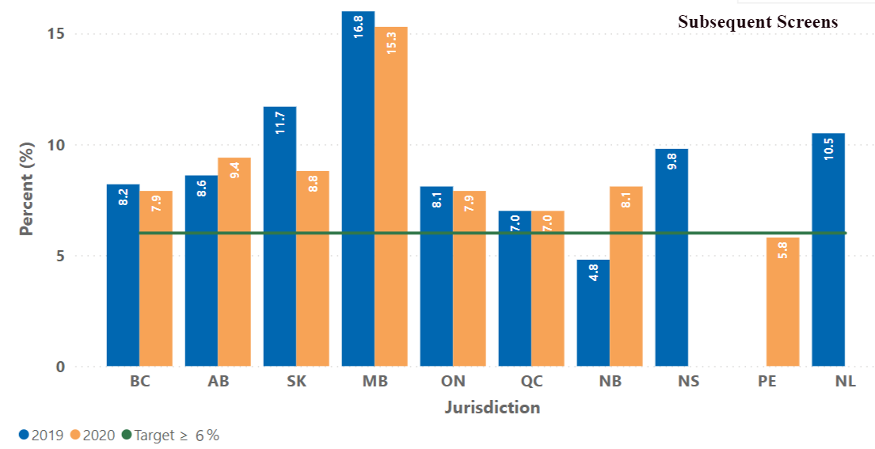
Percentage of individuals (aged 50-74) with abnormal mammograms who were diagnosed with breast cancer, by jurisdiction and screening sequence – 2019 and 2020
Notes:
Footnotes
SK: Data included individuals aged 50-69 since individuals aged 70-74 were not routinely invited. Screens that were lost to follow-up within 6 months of screening were not excluded.
NS, NL: Screens that were lost to follow-up within 6 months of screening were not excluded.
ON: Abnormal screens that were lost to follow-up were excluded, regardless of the 6-month period.
QC: Data included individuals aged 50-69 since individuals aged 70-74 were not routinely invited.
Data source: Provincial Breast Cancer Screening Programs.

Slide 18
Cancer Detection Rate

Slide 19
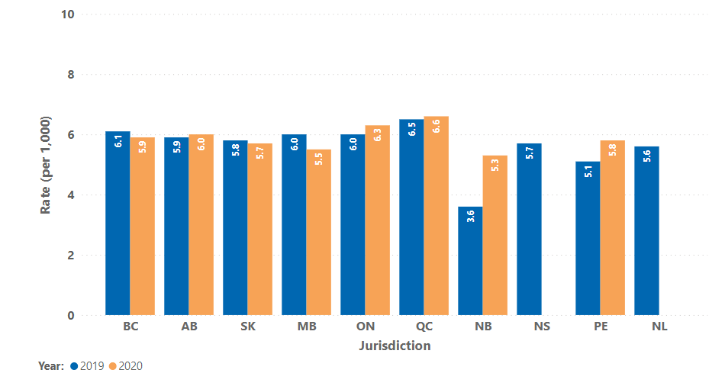
Cancer detection rate (per 1,000 screens) of breast cancers among individuals aged 50-74, who were screened within a screening mammography program, by jurisdiction — 2019 and 2020
Notes:
Footnotes
SK: Data included individuals aged 50-69 since individuals aged 70-74 were not routinely invited. Screens that were lost to follow-up within 6 months of screening were not excluded.
ON: Abnormal screens that were lost to follow-up were excluded, regardless of the 6-month period.
QC: Data included individuals aged 50-69 since individuals aged 70-74 were not routinely invited. Cancer includes in-situ, invasive and unspecified breast cancers.
NB, NS and NL: Screens that were lost to follow-up within 6 months of screening were not excluded.
Data source: Provincial Breast Cancer Screening Programs.

Slide 20
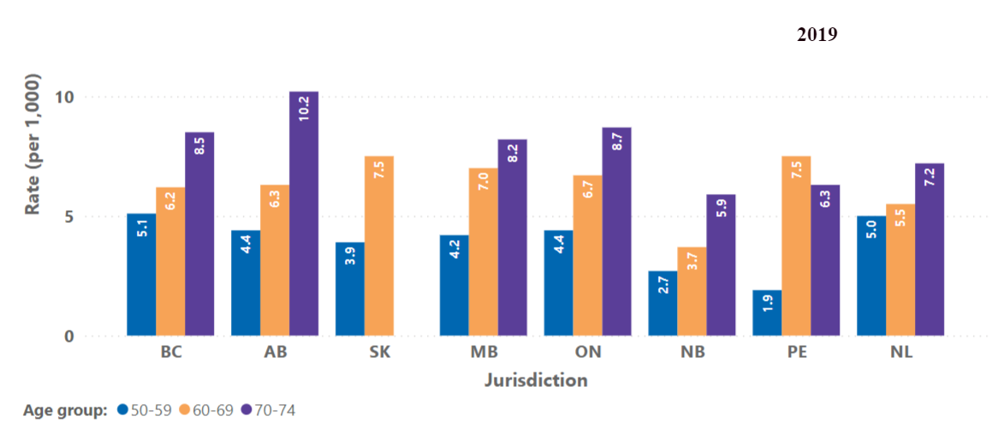
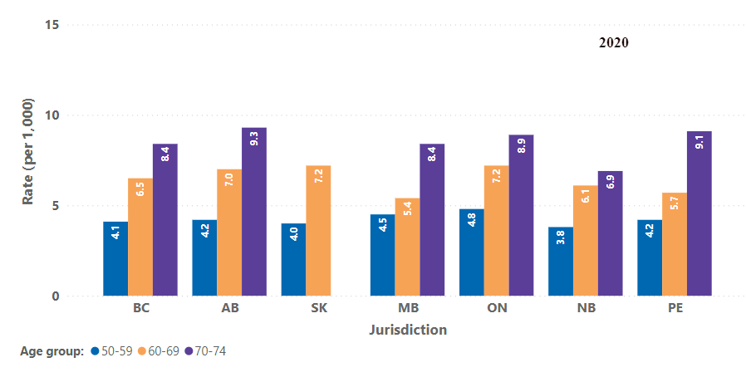
Cancer detection rate (per 1,000 screens) of breast cancers among individuals aged 50-74, who were screened within a screening mammography program, by jurisdiction and age group — 2019 and 2020
Notes:
Footnotes
SK: Data included individuals aged 50-69 since individuals aged 70-74 were not routinely invited. Screens that were lost to follow-up within 6 months of screening were not excluded.
ON: Abnormal screens that were lost to follow-up were excluded, regardless of the 6-month period.
NB, NS and NL: Screens that were lost to follow-up within 6 months of screening were not excluded.
Data source: Provincial Breast Cancer Screening Programs.

Slide 21
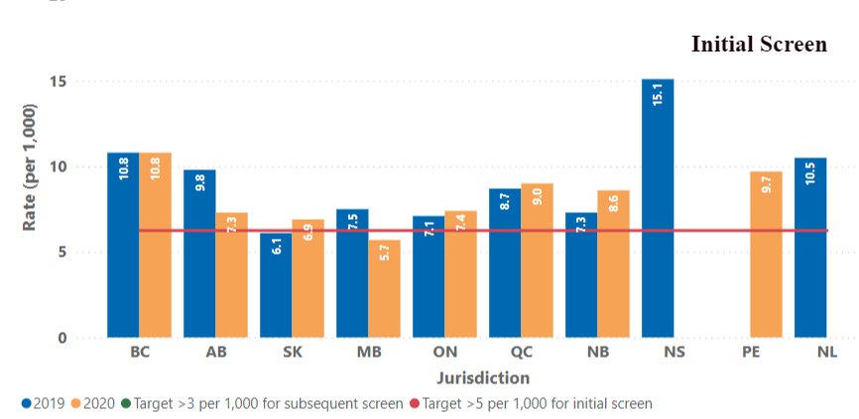
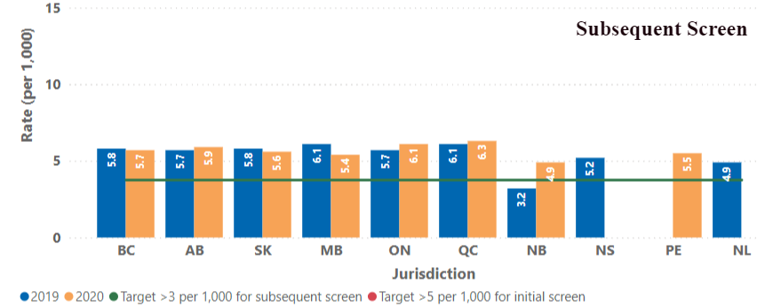
Cancer detection rate (per 1,000 screens) of breast cancers among individuals aged 50-74, who were screened within a screening mammography program, by jurisdiction and screening sequence — 2019 and 2020
Notes:
Footnotes
SK: Data included individuals aged 50-69 since individuals aged 70-74 were not routinely invited. Screens that were lost to follow-up within 6 months of screening were not excluded.
ON: Abnormal screens that were lost to follow-up were excluded, regardless of the 6-month period.
QC: Data included individuals aged 50-69 since individuals aged 70-74 were not routinely invited. Cancer includes in-situ, invasive and unspecified breast cancers.
NB, NS and NL: Screens that were lost to follow-up within 6 months of screening were not excluded.

Slide 22
Time to Diagnosis

Slide 23
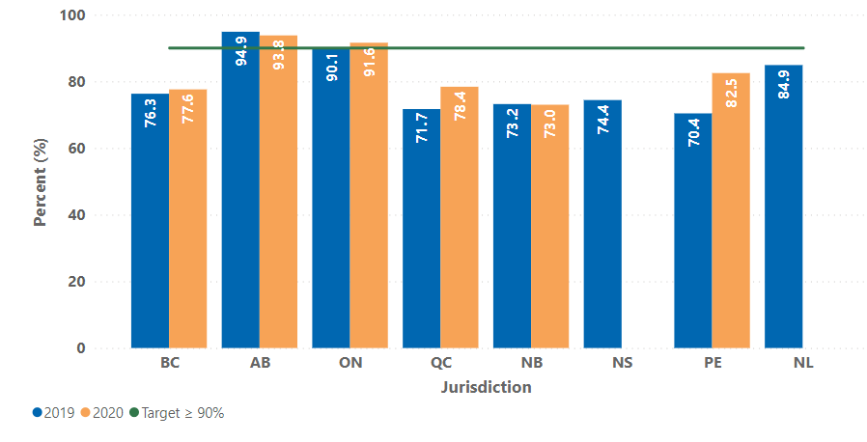
Percentage of abnormal screens among individuals aged 50-74 who had a definitive diagnosis without biopsy within 5 weeks, by jurisdiction — 2019 and 2020
Notes:
Footnotes
AB: Data included minor abnormal screens that moved out of province after screening.
ON: Abnormal screens that were lost to follow-up were excluded.
QC: Data included individuals aged 50-69 since individuals aged 70-74 were not routinely invited.
NB: Data for 2020 was incomplete.
Data source: Provincial Breast Cancer Screening Programs

Slide 24
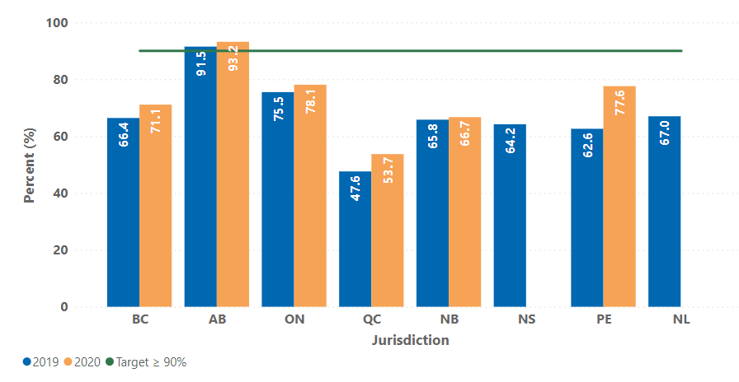
Percentage of abnormal screens among individuals aged 50-74 who had a definitive diagnosis with biopsy within 7 weeks, by jurisdiction — 2019 and 2020
Notes:
Footnotes
AB: Data included minor abnormal screens that moved out of province after screening.
ON: Abnormal screens that were lost to follow-up were excluded.
QC: Data included individuals aged 50-69 since individuals aged 70-74 were not routinely invited.
NB: Data for 2020 was incomplete.
Data source: Provincial Breast Cancer Screening Programs.

Slide 25
Post-Screen Cancer Detection Rate

Slide 26
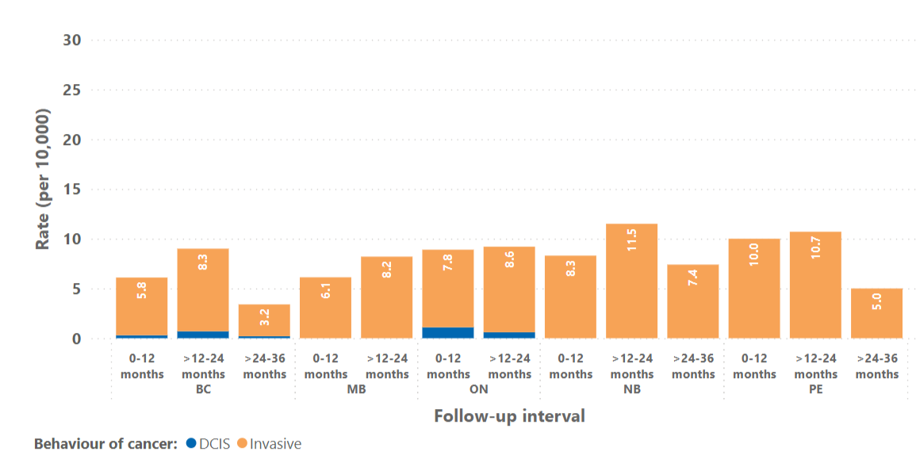
Post-screen diagnosed breast cancer rate (per 10,000 screens) among individuals aged 50-74 who were screened within a screening mammography program, by jurisdiction — screening year 2017-18
Notes:
Footnotes
MB: Data for DCIS and invasive breast cancer were combined to avoid residual disclosures of small numbers. Those with a bilateral mastectomy were not excluded.
NB and PE: Data for DCIS and invasive breast cancer were combined to avoid residual disclosures of small numbers.
ON: Screens for individuals lost to follow-up, deceased, or those who had a bilateral mastectomy during the follow-up interval were not excluded.
QC: Post-screen diagnosed cancer rate was 6.9 per 10,000 person-years for 0-12 months (based on screens in 2019) and 10.9 per 10,000 person-years for 12-24 months (based on screens in 2018). Data included individuals aged 50-69, the cancer included invasive breast cancer only. The post-screen cancers were measured at the end of 2020, the denominator was cumulative follow up in person-years after a negative screening episode.
Data source: Provincial Breast Cancer Screening Programs.

